Slide 1
Rust for Flight Software
11th Annual FSW Conference
December 2018

Slide 2
Advanced Space exists to support the sustainable exploration, development, and settlement of space.
Projects
Mission systems and enabling technology (Moon)
Robust and resilient orbital transfers (Security)
Interplanetary mission design (Mars)
Earth orbit and highly challenging spacecraft navigation
Trajectory optimization (chemical & electric)
Satellite constellation planning, design, and engineering
Spacecraft guidance and avionics
Spacecraft autonomy
Notes:
Moon, Mars, satellite

Slide 3
Outline
What is Rust?
Where does Rust shine?
Memory management
Error handling
Dynamic libraries
How have we used Rust?
Potential applications

Slide 4
What is Rust?
Systems programming language
Developed by Mozilla Research, used in Firefox
Formally-proven memory safety
Prevents segmentation faults and race conditions
Efficient C bindings
Dynamic library compilation for C linking
Leverages the Application Binary Interface (ABI)
Debuggable with gdb
Zero-cost abstractions and optimized compilation
Freely use structs, traits, and clean error handling
Reproducible builds, extensive testing tools, and more!

Slide 5
Memory management in Rust (1/4)
Rust tries to store every variable on the stack
Unless of variable length (like strings and mutable lists),
Or explicitly marked as heap-allocated
All primitives, and structures thereof, are initialized and sized at compile time
Rust uses the concept of ownership of data, which is enforced by the compiler
Each value in Rust has a variable that’s called its owner
There can only be one owner at a time
When the owner goes out of scope, the value will be dropped
All variables are read-only unless explicitly stated otherwise

Slide 6
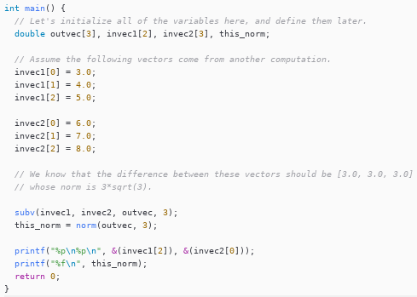
Memory management in Rust (2/4)

Slide 7
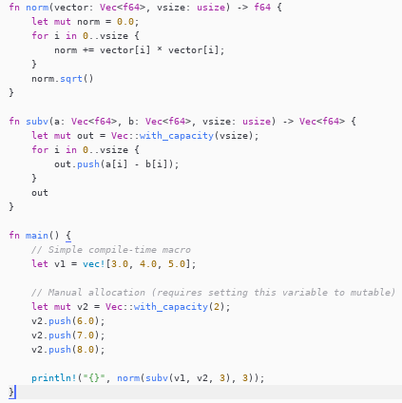
Memory management in Rust (3/4)

Slide 8
Memory management in Rust (4/4)
The C code returns an invalid value -- a silent failure
Accidently defined invec2 to be of size 2 instead of 3.
Even -Wall flag did not notice that we were overwriting stack data
Need for static analysis tools
Rust allocated on the stack as well
Compiler noticed three calls to push on vector v2
Compiler updated stack requirements to fix the programmer error

Slide 9
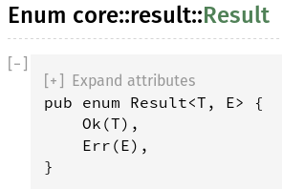
Error handling in Rust (1/2)
Rust introduces a type called Result
Represents either a success or a failure
Compiler checks that failure case are handled
Success and failure are containers for data of any type
That data lives in the scope of the error handling
Avoids the hazard err_no and use of uninitialized variables

Slide 10
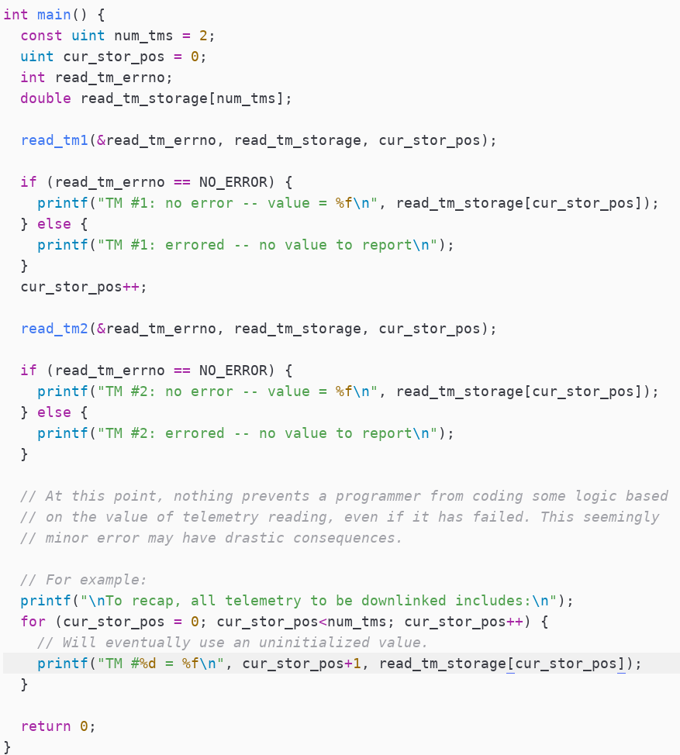
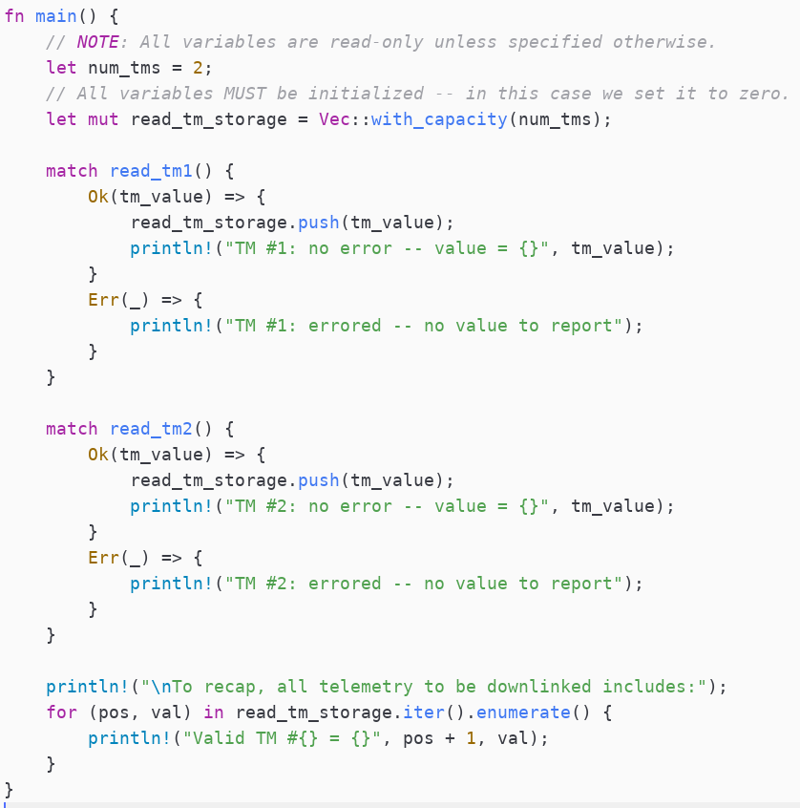
Error handling in Rust (2/3)

Slide 11
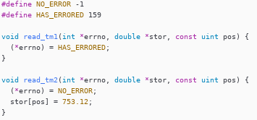
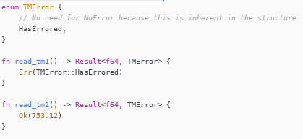
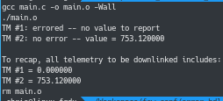
Error handling in Rust (3/3)

Slide 12
Dynamic libraries in Rust (1/4)
Benefit from all the advantages of Rust without full rewrites
Application Binary Interface enables very low overhead communication
Example:
Randomly generate two vectors of size three
Subtract one from the other and compute the L2 norm
Repeat 50 million times
Case | No external library | C library | Rust library
Execution time (seconds) | 5.28 | 5.30 | 8.37
Library size (MB) | N/A | 3.0 | 2.8

Slide 13
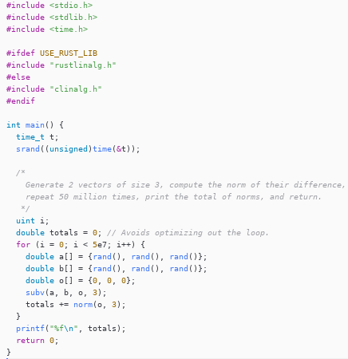
Dynamic libraries in Rust (2/4)

Slide 14
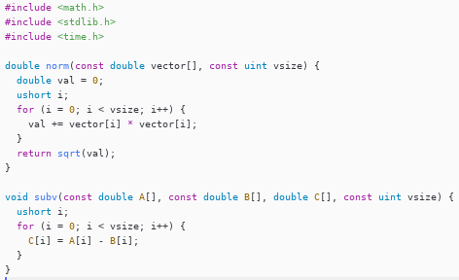
Dynamic libraries in Rust (3/4)

Slide 15
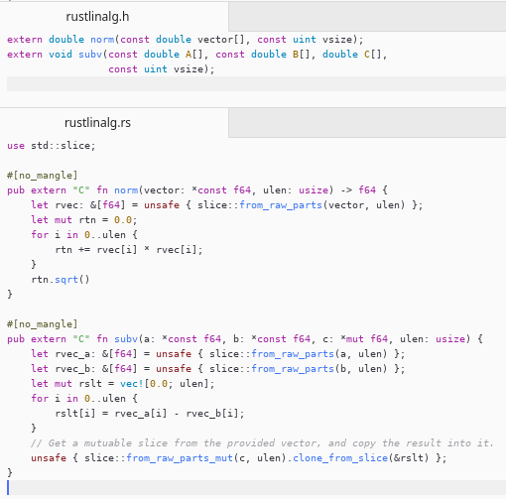
Dynamic libraries in Rust (4/4)

Slide 16
How have we used Rust?
Core Flight App communication using Protocol Buffers
Developed an orbit propagator interface in Rust
Developed a set of Protocol Buffer messages
Communication between Rust application and cFS App over TCP
Advantages
Orbit propagator tool developed “ported” to ARM platform without a single change in the code
Test suite executed in on a x86_64 environment, but guaranteed to work on ARM as well
Only possible for C applications which have an OSAL layer like cFE

Slide 17
Potential applications
Flight Software Frameworks
Zero-cost abstractions can enable shared traits between applications
Procedural macros allow compile-time optimization of routing
Memory safeties ensure no race condition happen within the app
Verbose yet versatile error handling allow for good readability
Platform limitations
Many Rust “crates” require the standard library
Requires Windows, Linux, MacOS, iOS, Fushia, some *BSD
Requires x86, x86_64, PowerPC, most ARM architectures, and some MIPS
If standard library not available, Rust can be compiled for “no-std”
Requires some customizations, but used in production for telematics

Slide 18
Any questions?
Chris Rabotin 561-206-2271 rabotin@advancedspace.com
https://github.com/AdvancedSpace/fsw_conf
https://github.com/ChristopherRabotin

