Slide 1
Packet Utilization Standard and Its Use in ESA Missions
Marek Prochazka, Piotr Skrzypek
ESA/ESTEC (Noordwijk, Netherlands)
December 2018

Slide 2
Outline
Packet Utilization Standard (PUS) overview
PUS use
  Space-to-Ground interface
  Onboard
  Design choices
PUS tailoring
PUS use for FDIR
PUS Benefits
Conclusions

Slide 3
What is Packet Utilization Standard (PUS)?
Complements the CCSDS Space Packet Protocol standard by specifying application-level interface between ground and space
Covers nominal, contingency and troubleshooting operations
Provides operational concept via a set of on-board services
Defines corresponding TM/TC packets (and their structures)
Allows to make a mission-specific tailoring of on-board services
Allows mission-specific extensions
Notes:
The PUS defines a set of standard services that satisfy all the fundamental operational requirements for spacecraft monitoring and control during spacecraft integration, testing and flight operations, as per ECSS-E-ST-70-11 [AD04]. It also specifies the structure and contents of the telecommand packets used to transport the requests and the telemetry packets used to transport the reports.
Comparing to the cFS
- Rather than having the same architecture and reusing the same code, ESA defined a standard and every supplier builds proprietary system and software architecture compliant to the standard

Slide 4
PUS History
ESA PSS-07-101 Issue 1 May 1994
  Shortly after CCSDS TM and TC specifications in late 1980s
  Not in use anymore
ECSS-E-70-41A 30 January 2003 (aka PUS A)
  Few improvements and clarifications
  Extensions (adoption of mission specific requirements/services)
  Applicable to most ESA missions
ECSS-E-ST-70-41C 15 April 2016 (aka PUS C)
  Adding “Foundation Model”
  Extensions (adoption of mission specific requirements/services)
  Applicable to upcoming missions
Notes:
ESA foresaw a potential problem whereby missions utilising CCSDS packets would implement their own mission-specific solutions, with a consequent proliferation of bespoke on-board packet management systems and supporting ground monitoring and control applications. Therefore, in the early 1990s, the ESA Committee for Operations and EGSE Standards (COES) was charged with the task of developing a standard for how packets should be used, which would satisfy the operational requirements of a broad range of missions. The first ESA Packet Utilisation Standard was produced by COES in 1994 and became the ‘de facto’ standard for all ESA missions thereafter:
When the responsibility for the production of pan-European Space standards was transferred from ESA to ECSS, a re-issue of the PUS standard was deemed timely. Several ESA and non-ESA missions had applied the standard since its first issue (XMM, Integral, Rosetta, Envisat, ATV, Proba, MSG) and a body of operational experience had already been acquired. As a consequence, many suggestions had been tabled for extending and improving the PUS.
The first ECSS issue of the PUS (ECSS-E-70-41A) published in 2003 has been going through a technical review and subsequent update in recent years. This effort resulted in the publication of the second issue in April 2016.

Slide 5
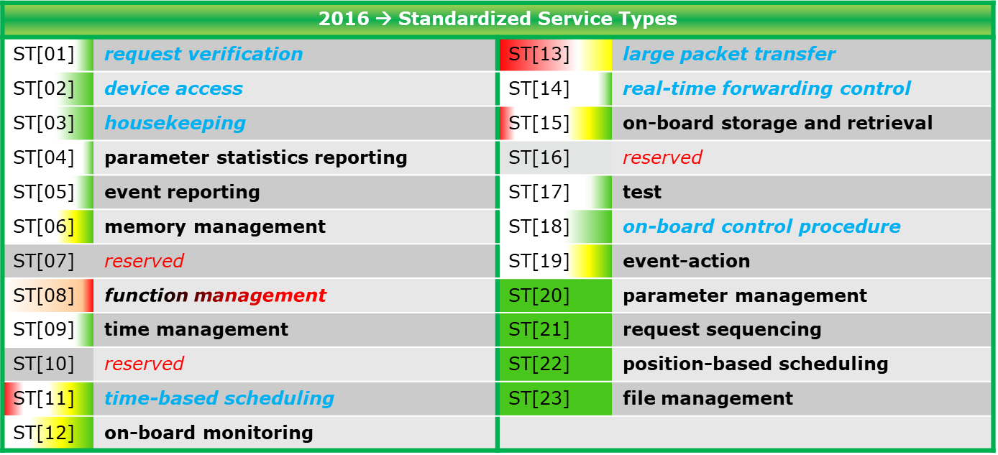
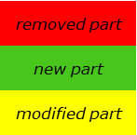
PUS Services
Notes:
Some of these services might be familiar to you, because there are similar apps in cFS (Memory Manager, Scheduler, Event Services, Time, Services, Data Storage)

Slide 6
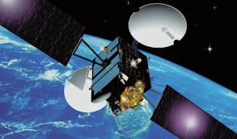
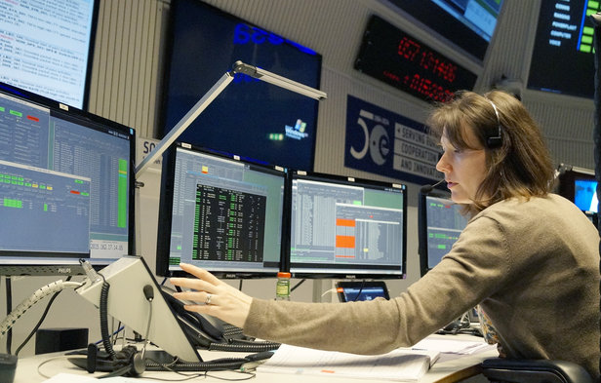
PUS Use in ESA Missions
Originally meant
for ground-to-space
communication/interface
Nowadays in most ESA missions used also onboard
  Multiple APIDs per spacecraft
    Different applications (Data Handling, AOCS, System Control, …)
    Different units (Startracker, GNSS receiver, Mass Memory Unit, …)
Notes:
Global Navigation Satellite System (GNSS)

Slide 7
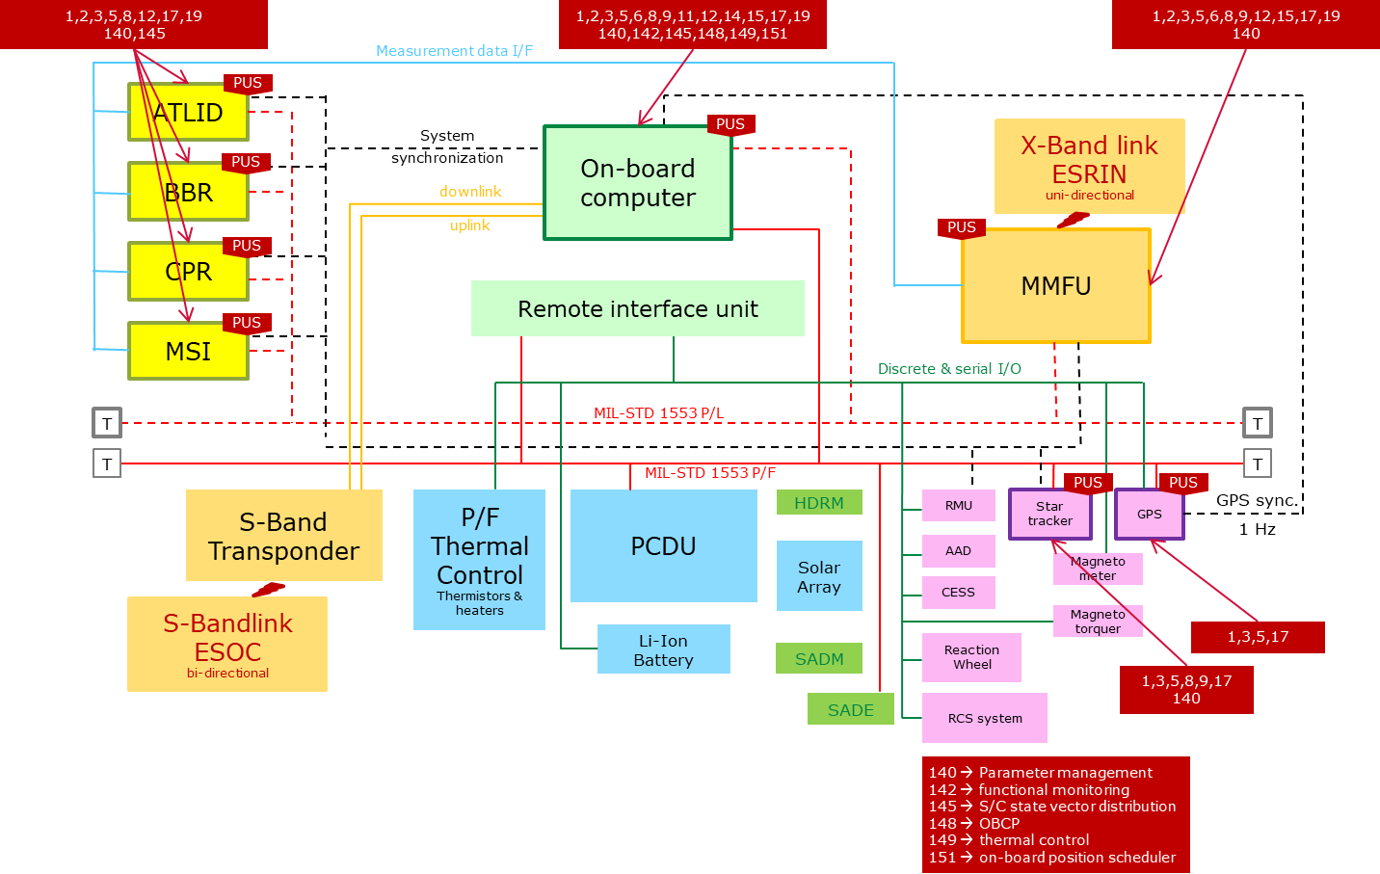
Example: PUS Onboard (EarthCARE)

Slide 8
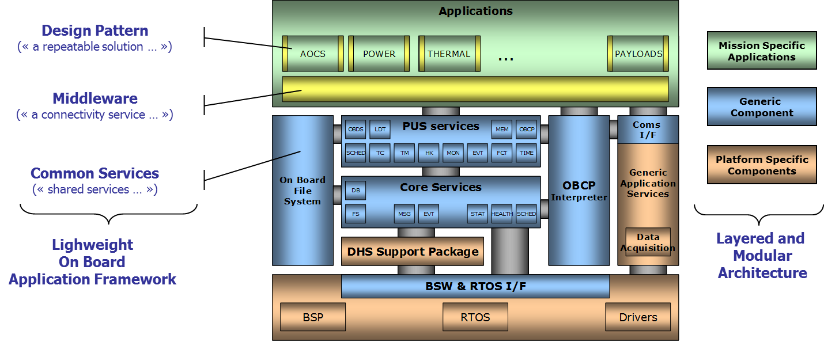
Example: PUS in Central Software on OBC

Slide 9
PUS Link to CCSDS Packet - TC

Slide 10
PUS Link to CCSDS Packet - TM

Slide 11
PUS Tailoring
Every ESA mission specifies its PUS tailoring
Selection of PUS services
  With all mandatory subservices and minimum capabilities
For each service selecting additional capabilities
  Optional subservices
Additional (mission-specific) services and subservices
  Managing additional (mission specific) onboard capability
  Managing onboard unit
Choosing encoding of data types
  Packet field type code (PTC)
  Packet field format code (PFC)

Slide 12

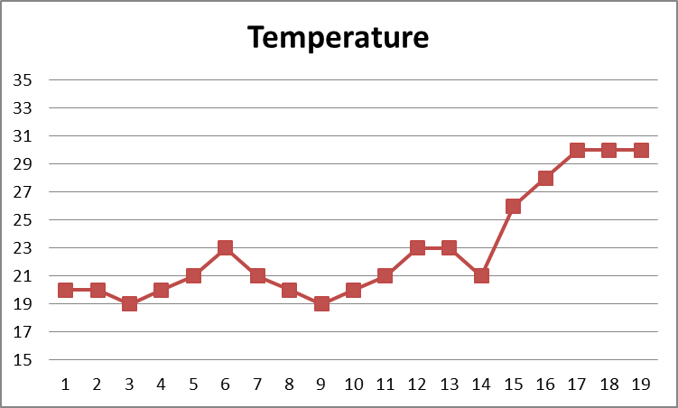
FDIR: Using PUS Services
Service 12
Monitoring
Event notification
Service 5
Event Reporting
Event notification
TC
Service 19
Event Action
PUS (5,2) packet
PUS (5,4) packet
Start OBCP
Packet store/File
Service 18
On-Board Control Procedure
Critical Event Log
Service 15
Storage and Retrieval
Service 14
Packet Forwarding
Notes:
Part of hierarchical FDIR
Upper limit, lower limit
Critical upper limit, critical lower limit
All of this is not hardcoded, but instead it is PUS services configuration

Slide 13
Benefits for Flight Software
Standard data handling architecture
Standard telecommands and telemetry
Standard terminology
Cost saving in FSW
  Both engineers and operators familiar with the concept
  Reuse PUS libraries in FSW (customization/configuration per mission)
  Lightweight PUS tailoring suitable for inter-partition communication in IMA-like partitioned systems
When used in instrument software
  Provides transparency for the platform
    Strength when developing or hosting CFIs
    Satellite prime contractor can provide instrument PUS SW toolkit
  OBCPs can be used for nominal instrument operations

Slide 14
Benefits for Ground Software
Operators familiar with PUS
TC and TMs captured in standard MIB database
Range of software products that can be reused from mission to mission
  SCOS-2000 database
  Mission control system (SCOS-2000, Terma TSC)
  Checkout system (Terma CCS)
  Data mining and visualization tools (WebMUST, Airbus's “packet viewer”, packet archives - EDDS, GDDS, etc.)

Slide 15
Conclusion
PUS used in “all” ESA missions since early 2000s
Successful concept
  Contributing to (standardized) software architecture
  Standardised operations concept
  Standard way to support mission specific applications
Future
  Use Electronic Data Sheets (EDS) to describe PUS interfaces
    Machine verifiable
    To generate proprietary code, tests, simulation models
    To feed spacecraft database
  More mission-specific services becoming standard
  Standardised tailoring/profiles?

Slide 16
THANK YOU
Questions?
Marek Prochazka
ESA/ESTEC
Contact: Marek.Prochazka@esa.int

Slide 17



Backup slide: PUS Version “C”
ECSS-E-ST-70-41C
New subservices of existing services
New services
New document structure
  Generic Foundation Model: 121 requirements
  System specification: 2216 requirements
  Interface specification: 850 requirements
Issue C
2016

