Slide 1
A case study of implementations of SBN with SpaceWire
Mitsutaka Takada, Hiroaki Takada(Nagoya University),
Keniichi Matsuzaki(JAXA)

Slide 2
Contents
Motivation to use cFE/CFS
How to use SpaceWire with CFS. - SBN -
Build method and load setting of SBN using UDP module
Status of SpaceWire module in SBN source code
SBN data structure of SpaceWire module and correction of module IF
Introduction of “SpacePi” – SpaceWire appliance board on RasberryPi
Correction points for using SBN with SpacePi
Implementation result of SpaceWire module
Conclusion

Slide 3
Motivation to use cFE
In Japan, SpaceWire is adopted as the intra-satellite network mainly for medium / large science satellites.
By using SpaceWire, flexible network configuration and remote access with RMAP become possible. However, since application developers are required to know the constraint conditions and SpaceWire specification requirements to develop communication application, a standard interface and platforms are needed to expand the usage.
In satellite application development, we think that building a standard interface and software platform such as cFE/CFS , SOIS and so on is important, so that we have been examining the use of cFE /CFS and porting for spacecraft onboard in collaboration with JAXA and Nagoya Univ.

Slide 4
What are the conditions of spacecraft software platform?
In considering the software platform, we conducted a survey with the following conditions:
SpaceWire protocol service can be used from an app
Open standard API or Open-source software are provided
Specification is available both within and outside Japan
The following specifications are being investigated :
JAXA Internal Software Platform, SOIS, CFE/CFS…

Slide 5
SBN Build Method and Load Setting
Load method
SBN is one application of CFS, and SBN starts up like other CFS applications by setting SBN as CFE_APP with a script file (cfe_es_startup.scr)
SBN protocol modules are also built according to the classification of the CFE application, but the SBN loads the module to be used from the tablefile to be read at startup without loading from script file.
SBN_AppMain → LoadConfTbl → Modules(UDP,TCP,SpaceWire…)
Build method（Using Makefile）
Copy from SBN and SpaceWire module folders to $CFE_HOME/apps
Modify Makefile ($CFE_HOME/apps/sbn/fsw/for_build/Makefile)
Option OBJS files（comment out sbn_netif.o, sbn_loader.o）
Modify $CFE_HOME/build/cpu1/Makefile
Add spacewire module at build file section

Slide 6
Status of SBN modules
UDP module
Use “announce””heartbeat” internal message to determine the time the peer is connected to the network( and send subscription)
TCP
DTN
Using ION-DTN 3.6.0 library
Serial
Support standard serial driver
SpaceWire
Not supporting the latest version
Interface structure remains as previous version
Since there is no body code of the SpaceWire module (only IF code and stub code), actual transmit and reception cannot be performed

Slide 7
Ex. Using CFS App with SpaceWire
Via SBN
RMAP, SpW-D, SpW-R
cFE
Apps
(xS)
cFE
Apps
(xS)
cFE
Apps
(xS)
cFE
Apps
(xS)
SBN
SpW
App
SpW
module
Core Flight Executive(cFE)
SB
ES
cFS Platform Support Package (PSP) API
OS Abstraction API(OSAL)
SpaceWire middleware
CPU

Slide 8
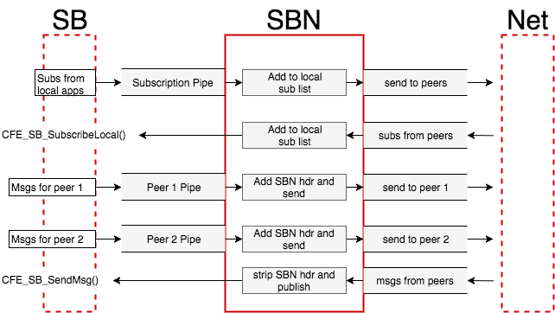
About SBN
One of the CFS applications
Application of inter-processor communication
Between lower layer and SBN communication uses socket or file description interface (However can we call own driver IF ?)
Any communication protocol can be used
SBN has Pub/sub function, and update communication information with peer table

Slide 9
Todo with SpaceWire module
Make SpaceWire module in SBN compatible
Send and receive the SpaceWire packet with SBN interface
Communication between “SpacePi”
Sender : Send the SpaceWire data determined from the CFS apps
Receiver : Wait for reception and check with transmit data

Slide 10
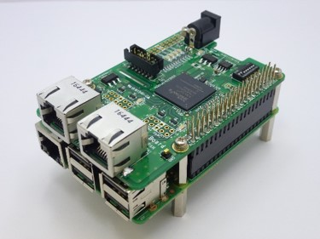
Space Pi
SpaceWire Appliance Reference Board(Shimafuji Electric Co,)
This communication board support 2 SpaceWire ports.（RJ-45）
This board is compatible with Rasberry Pi3 extension connector.
Sample program has been prepared to use for SpaceWire programing.
http://www.shimafuji.co.jp/en/products/960
FPGA | Spartan-6（XC6SLX16-2FTG256I）
SpaceWire | 2 Port （RJ-45） Link Speed：50Mbps（MAX）
Raspberry Pi I/F | SPI
Size | 65（W）mm × 56（D）mm
Power | +5V （Supply from Raspberry Pi or AC adapter） Option : AC adapter

Slide 11
Changeset SpaceWire module at SBN 1.10
Change file name of SpaceWire module
spw_sbn_if.c → sbn_spw_if.c
Change related Makefile and include directive in C program files
Update data structure(Peer/Net)
SpaceWire module had dummy(only entry point) data structure
Remove structure of module entry point ( because of loading method was changed)
Update module API table structure
Update structure name
SBN_InterfaceOperations → SBN_IfOps_t
However, limited the API to be use for checking operation

Slide 12
Changeset SpaceWire module at SBN 1.10
Add EventID
New file : sbn_spw_events.h
Event type : CONFIG, DEBUG
Implement the SpaceWire service operation(body) code
Support MESSAGE TYPE: only SBN_APP_MSG
Realize the SpaceWire communication with “Space Pi” at a low const
“Space Pi” has provided SPI driver codes

Slide 13
Peer/ Net data structure
What should be described in Peer Data and Net Data of SBN
necessary communication elements with SpaceWire
initiator
target
P3
P1
P1
P3
P4
P2
P2
P4
Data elements | Cf. communication config
Path Address | P1, P4
Logical Address | 0xFE(default value)
Reply Address (optional RMAP) | P2, P3
Key (optional RMAP) | 0x02(Space Pi default value)
SpaceWire protocol ID(optional) | 0x01(RMAP)

Slide 14
Support SpaceWire IF API （IFOperation Table)
IF name | UDP | SpaceWire
InitModule | SBN_UDP_Init | SBN_SPW_Init
LoadNet | SBN_UDP_LoadNet | SBN_SPW_LoadNet
LoadPeer | SBN_UDP_LoadPeer | N/A
InitNet | SBN_UDP_InitNet | SBN_SPW_InitNet
InitPeer | SBN_UDP_InitPeer | N/A
PollPeer | SBN_UDP_PollPeer | N/A
Send | SBN_UDP_Send | SBN_SPW_Send
RecvFromPeer | N/A | N/A
RecvFromNet | SBN_UDP_Recv | SBN_SPW_Rcv
ReportModuleStatus | SBN_UDP_ReportModuleStatus | N/A
UnloadNet | SBN_UDP_UnloadNet | N/A
UnloadPeer | SBN_UDP_UnloadPeer | N/A

Slide 15
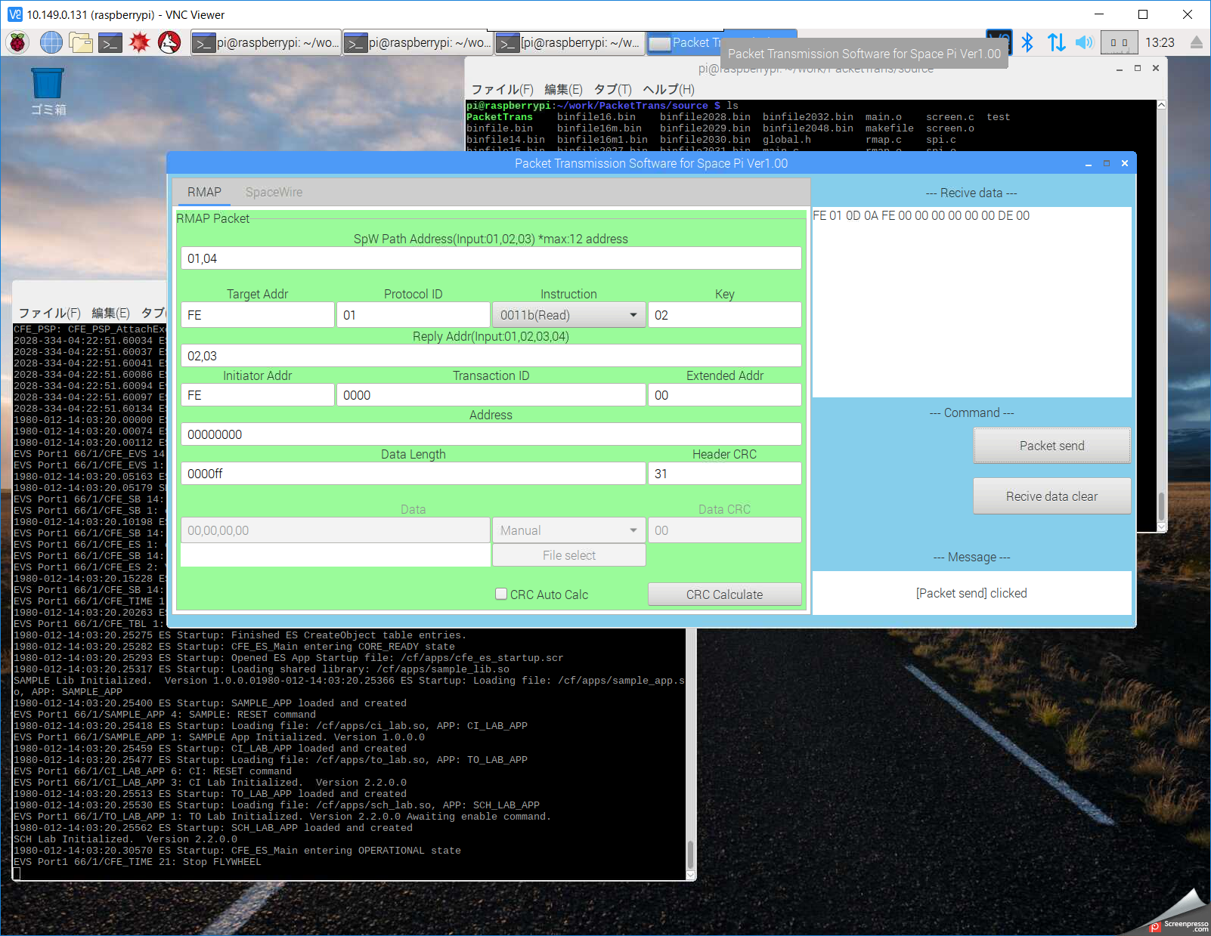
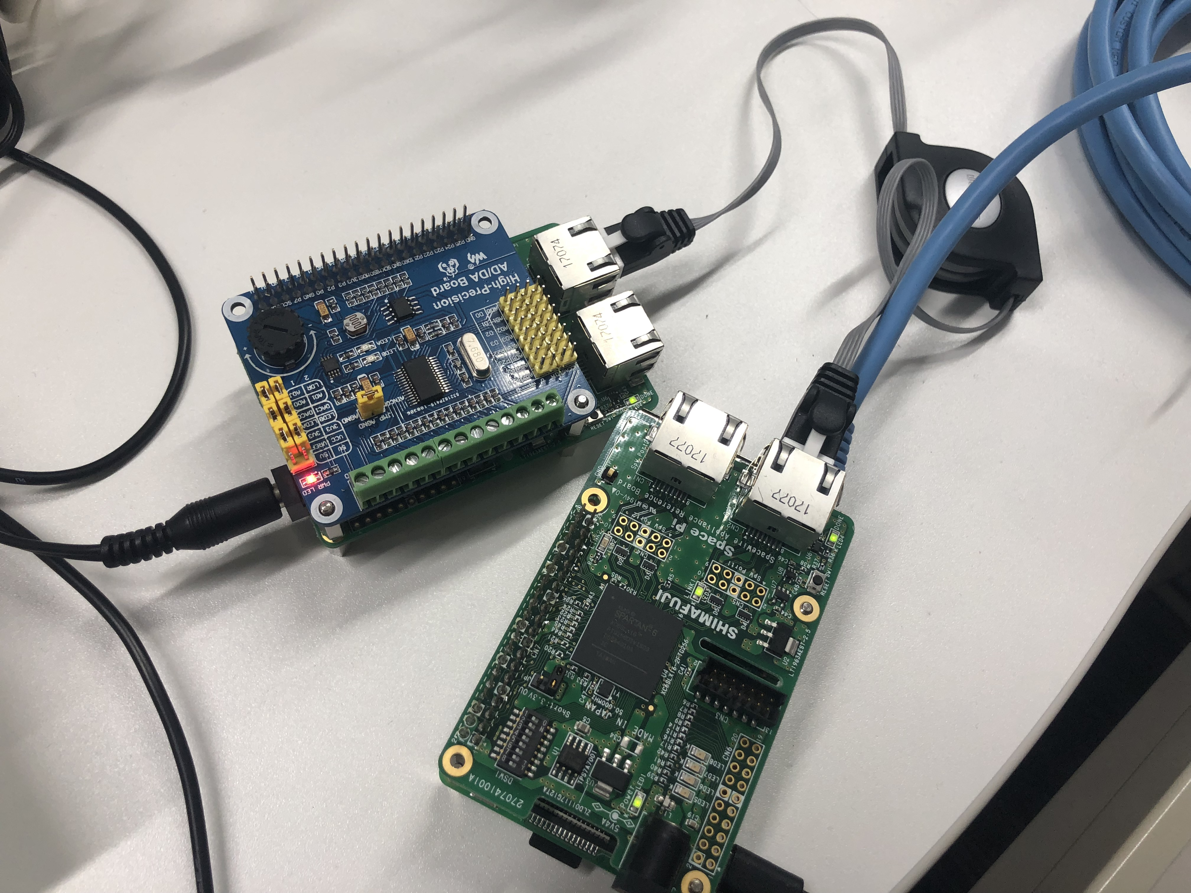
Demo(sensor data sampling)
High-Precision AD/DA Board is connected to Space Pi(SpW target board)
Initiator board read target board sensor data with SpaceWire
Target AD/DA board
SpaceWire cable (RJ-45)
SpaceWire App
RPi3+Space Pi
cFE sample + SBN

Slide 16
Conclusion
Conclusion
SpaceWire module can support partial SBN IF API
SpaceWire communication using SBN IF(or CFS APP)
Future plan
Implementation of no-support SBN IF
A study of use-case on SpaceWire upper layer protocol（RMAP, SpW-R, SpW-D）
Exchange Peer table
Heartbeats SB message （SpW-R vs SB）
Communication use-case via multiple protocols

