Slide 1
CADU and CLTU on COSMOS
FSW2018
Presenter: Nickollas de Oliveira Aranha
Authors: Nickollas de Oliveira Aranha, Edipo Crispim Alencar Souza

Slide 2
Agenda
Institutional
Introduction
Development
Functions
Github
Final Remarks
Thanks

Slide 3
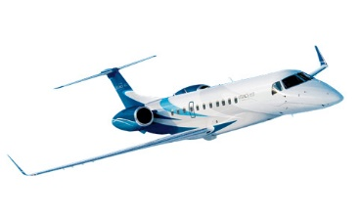
Institutional
Joint-venture Space Start-Up company located in São Paulo, Brazil.
Founded in 2012
Employees: ~60
50% engineers
3 engineers allocated to FSW and GSW
Main Project: SGDC (GEO telecom Ka-Band spacecraft launched in May, 2017)
(51%)
(49%)
Notes:
Suggest for this slide

Slide 4
Introduction
CCSDS
Channel Access Data Unit
Communications Link Transmission Unit
COSMOS
User Interface for command and control of embedded systems.

Slide 5
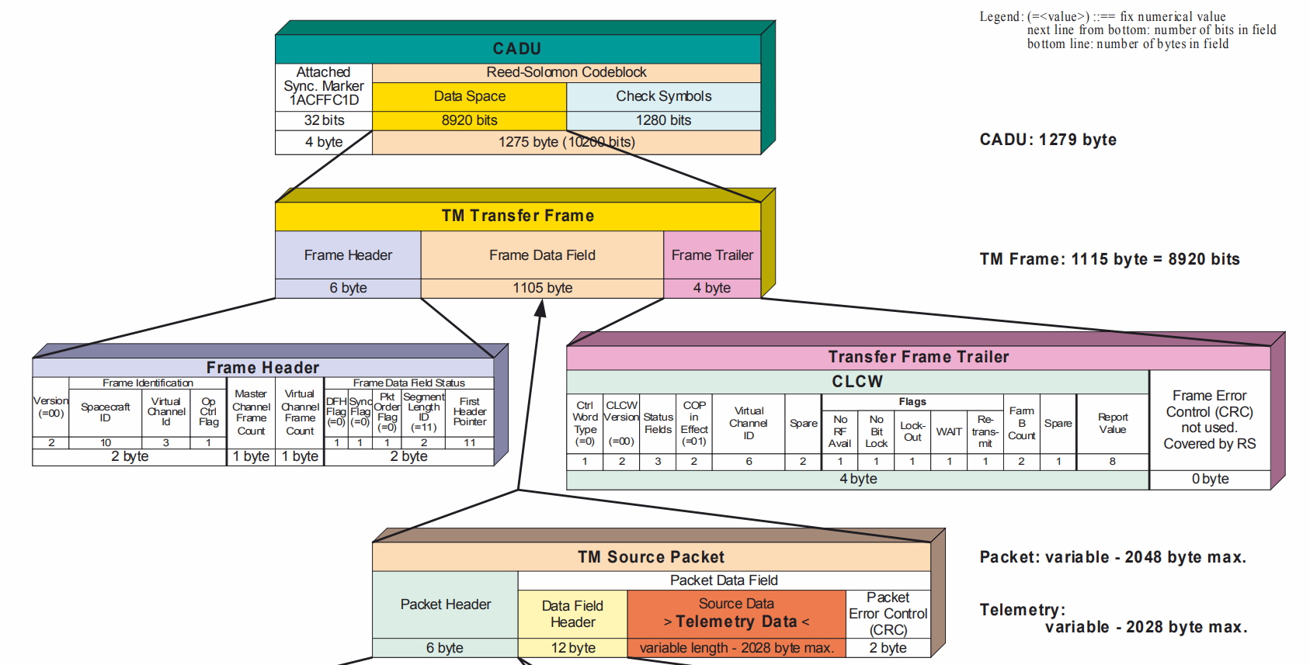
Introduction

Slide 6
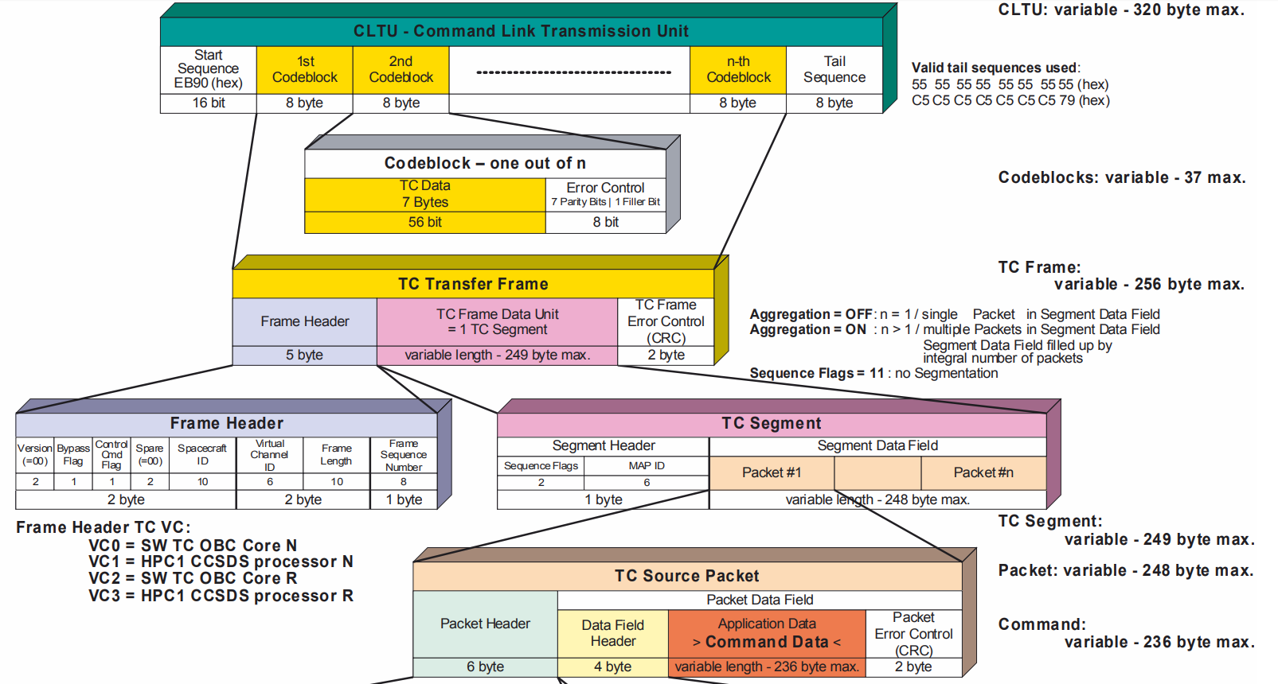
Introduction

Slide 7
Development
Architecture
Spacecraft
COSMOS
cFS
Read Protocols
CMD/TLM Server
TO
CADU
CCSDS
Handles Data
Write Protocols
CI
CLTU
CCSDS

Slide 8
Development
cFE
COSMOS
cFE version 6.5.0.0
OSAL 4.2.0.0
PSP 1.3.0.0
TO version 1.0.0.0
CI version 1.0.0.0
version 4.1.1

Slide 9
Functions
CADU
CLTU
Multi-Channel support
Handles Command Sequence Number
Handles Frame Sequence Number
Check CLCW flags
Unlock transmission command
Reset frame sequence number
Set frame sequence number
Set V(R)
Bypass next command

Slide 10
Functions

Slide 11
Github
Code and instructions available at:
github.com/edipovisiona/cadu-cltu
nickollas.aranha@visionaespacial.com.br

Slide 12
Final Remarks
FSW 2017: CFDP Engine on COSMOS
FSW 2019 (planned): cFS use in a CubeSat mission (TBC)

Slide 13
Special Thanks
David McComas (NASA GSFC)
Alan Cudmore (NASA GSFC)
Jason Thomas (Ball Aerospace)
Ryan Melton (Ball Aerospace)

Slide 14
CADU and CLTU on COSMOS
THANK YOU!
Presenter: Nickollas de Oliveira Aranha
Authors: Nickollas de Oliveira Aranha, Edipo Crispim Alencar Souza

