Slide 1
RTEMS Status and Roadmap
Joel Sherrill
Joel.Sherrill@oarcorp.com
OAR Corporation Huntsville Alabama USA
December 2018

Slide 2
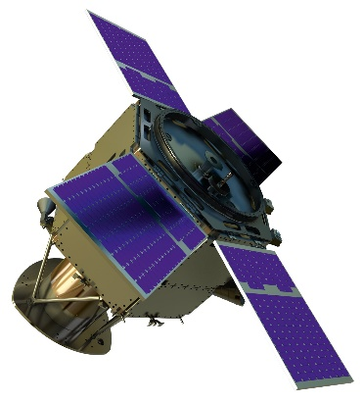
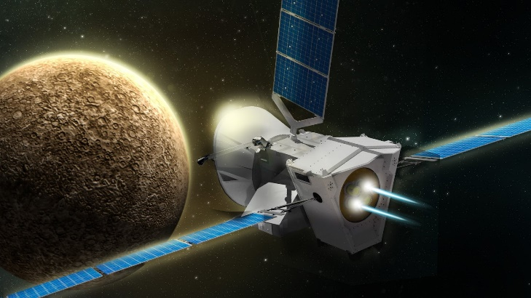
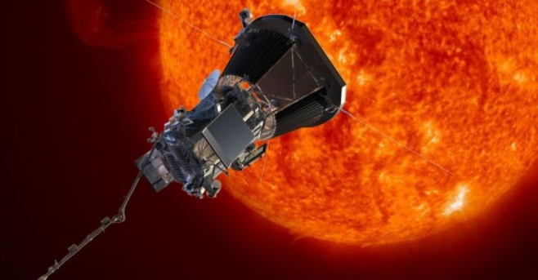
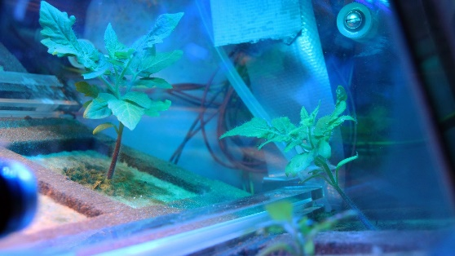
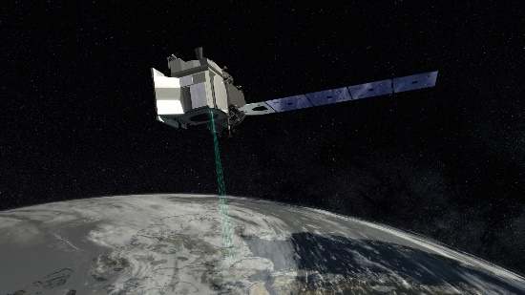
Recent RTEMS Mission Launches
NASA Parker Solar Probe
Launched 12 August 2018
SPARC Flight Computer runs RTEMS
DLR Eu:CROPIS
Launched 19 November 2018
SPARC based life-support, growing tomatoes in space
UAE KhalifaSat
Launched 29 October 2018
SPARC LEON3 based remote sensing satellite capable of imaging the earth at 0.7 meters
NASA ICESat-2
Launched 15 September 2018
Advanced Topographic Laser Altimeter System (ATLAS) runs RTEMS on a mix of SPARC and PowerPC CPUs
ESA BepiColombo
Launched 8 October 2018
RTEMS on at least MERTIS (MErcury Radiometer and Thermal infrared Imaging Spectrometer)

Slide 3
Overview
RTEMS Version Numbering Changes
RTEMS 5.1 Highlights
RTEMS libbsd TCP/IP and USB Status
Documentation Status
Google Summer of Code Projects
Desirable RTEMS Ecosystem Capabilities
Hosting News
Qualification Activities
Relicensing Activities
Deos/RTEMS

Slide 4
RTEMS 5 Explanation
Architectural changes significant enough to justify changing the first digit from 4 to 5
SMP support is mature and optimized
Target name is CPU-rtems5 tools
Also changing from 3 digit to 2 digit release version numbering scheme (like GCC)
Versions will be 5.1, 5.2, etc.
Release series after 5 will be 6

Slide 5
Highlights of RTEMS 5.1
Burndown list of remaining issues:
https://devel.rtems.org/milestone/5.1
Help is appreciated
C, C++, Ada and FORTRAN available via RSB
System initialization via constructors
results in even smaller executables
POSIX APIs now enabled by default
POSIX synchronization objects are self-contained
POSIX header files now in newlib
C11 threading and synchronization supported including thread local storage
Significant reorganization and simplification of build system
Sixty-four bit time_t
Python 2 deprecation forced need for seamless 2/3 detection and use
See https://legacy.python.org/dev/peps/pep-0394/ for details

Slide 6
More Highlights of RTEMS 5.1
JFFS2 updated to upstream
Flattened Device Tree (FDT) support
xz decompression support
Sixty-four bit PowerPC support
Support for QorIQ DPAA including 10 Gbit/s Ethernet
Build system improvements
Removal of pre-installing header files
Flattening of library build under cpukit
Massive improvements in build parallelism
Test suite improvements
Improved annotation of test executable for test auditing
Addition of 90+ test executables

Slide 7
SMP Highlights of RTEMS 5.1
SMP supported on SPARC, ARM, PowerPC, and RISC-V
Scalable timer support for SMP systems
Priority queues for timers (e.g. red-black trees)
Timer expiration distributed across processors
Fine grained locking
Big Kernel Lock removed
Locking Protocols for Mutual Exclusion
Transitive priority inheritance
priority inheritance tracked across multiple resources
Priority ceiling
O(m) Independence-Preserving Protocol (OMIP)
extends priority inheritance to clustered scheduling
Multiprocessor Resource-Sharing Protocol (MrsP)
extends priority ceiling to clustered scheduling

Slide 8
RTEMS Libbsd Status
Tracking latest FreeBSD
Started with FreeBSD 6, now at 12
SMP performance improvement with self contained objects
Configuration follows FreeBSD system administration
Simplified initialization via /etc/rc.conf
USB with these Device Classes:
Input, Serial, Networking, Wlan, Storage
Flattened Device Tree (FDT)
MMC (eMMC)
Networking:
IPv6, IPv4, IPsec, Packet Filter
Wireless
OpenCrypto, OpenSSL
Drivers: RE, FXP, E1000, DC, SMC, Broadcomm, plus some SoC specific including QorIQ DPAA and 10GigE
Commands: tcpdump, ifconfig, route, ping
mDNSResponder (Bonjour)
DHCPD
VLAN
Over 50 examples and tests
Drivers and features added as requested (e.g. funded) by users.

Slide 9
Architecture and BSP Highlights in 5.1
Added:
Architectures: RISC-V 32 and 64 bit, x86_64
BSPs: atsamv, imx7, qoriq_e500, qoriq_e6500 (32 and 64 bit), at697f, gr712rc, gr740, ut699, ut700
BSPs supporting SMP:
SPARC (1-4 cores): GR712C and GR740
PowerPC (1-24 cores): QorIQ (e.g. P1020, P2020, T2080, T4240, etc.)
ARMv7-A (1-4 cores): Altera Cyclone V, Xilinx Zynq, Raspberry Pi2
RISC-V (1-2 cores): RISCV
Removed
Architectures: AVR, H8/300, M32C, M32R
BSPs: gba, gp32, nds, Edison, gen68302, idp, mvme136, od368302, sim68000, simcpu32, genmongoosev, ep1a, mbx8xx, sis

Slide 10
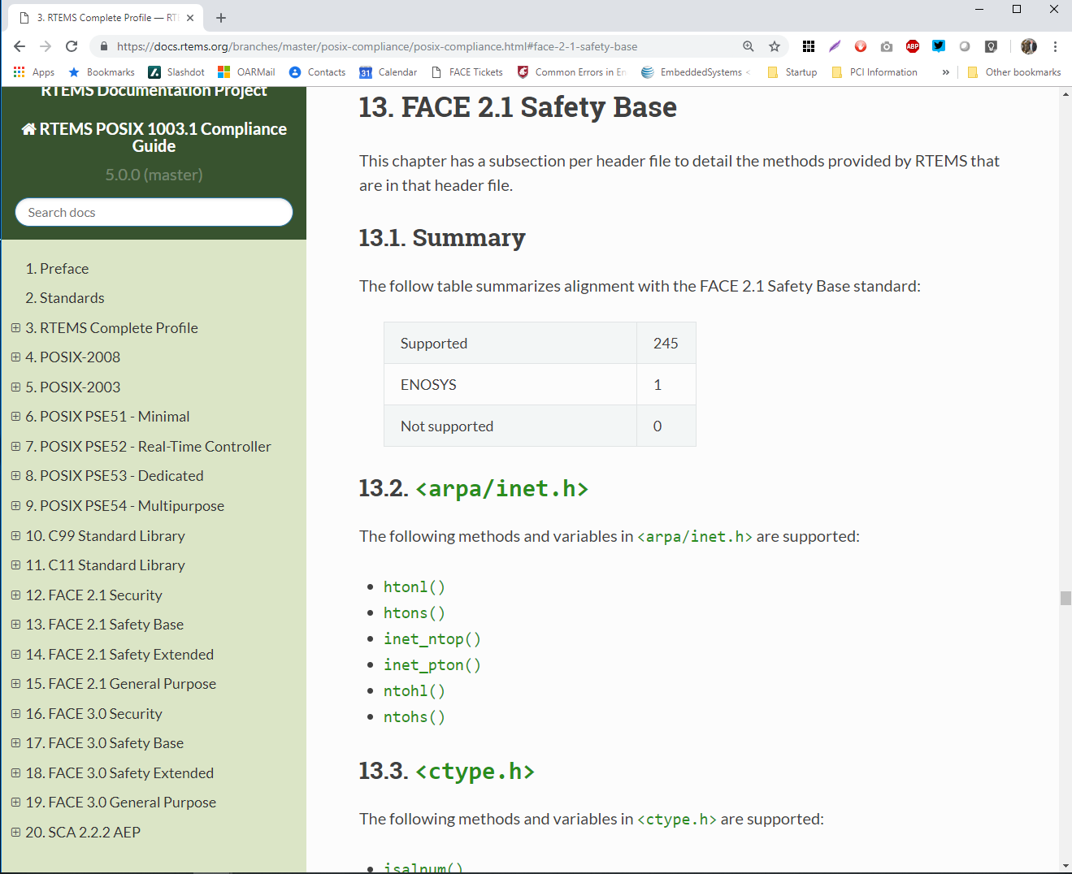
RTEMS Documentation Status
Sphinx
Used by Python and recently adopted by Linux kernel
Simple ASCII markup
sphinx-doc.org
New:
Updates to User, RSB, BSPs, and POSIX Compliance Guides
SPARC Calling and Annul Slots
Progress on inclusion of newlib documentation
Wanted:
Inline programming examples
BSP Specific Howtos
Guides to common tasks and problems
Easy to contribute!

Slide 11
Google Summer of Code Projects

Slide 12
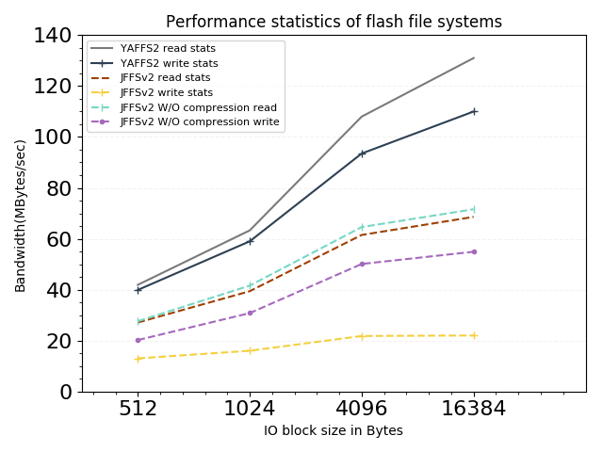
Filesystem benchmarking and porting FreeBSD’s SDIO driver - Udit Agarwal
What was set to be done -
Selecting and porting a multi-purpose benchmarking tool
Porting FreeBSD’s SDIO stack to RTEMS
Benchmarking various block device drivers and filesystems
Project motivation
Extensive use of SDIO on embedded platforms for interfacing IO devices
Quantitative performance evaluation of various filesystems
What was actually done -
Flexible IO tester(FIO) was ported to RTEMS
Ported SDIO stack works upto a large extent, however, few bugs left to be resolved.
Extensive benchmarking of all the filesystems available on RTEMS was done
Lessons/Skills learned:
Got a pretty broad insight of
Functioning of different filesystems
FreeBSD’s CAM framework
Different aspects of benchmarking
Efficient time management

Slide 13
Release Notes Generator & RTEMS POSIX User Guide Generator - Dannie Huang
Summary & Motivation:
The first project implemented a release notes generator, which parses website tickets.
The second project convert Newlib markup to Sphinx output and integrate with POSIX users guide.
Newlib has approximately 400 documented libc, and libm methods included with RTEMS
My motivation to do these project is because Doc generation is an important but undervalued aspect of open source project.
Output & Impact:
After fetching needed information by parsing XML page, Markdown version of release notes can be generated by using python 2.
C-style block comments with makedoc format in C source file with Regular Expression matching can also be parsed by using python 2.
Impact is significant since software developers in open source community can get needed data from code in a easier way.

Slide 14
Improve Coverage Analysis Toolset – Vijay Bannerjee
Objective of the Project:
Develop a Script for RTEMS Tester to generate HTML coverage report.
Integrate GCOV support in the covoar tool, which is used by RTEMS for Coverage analysis.
Outcome of the Project:
RTEMS Tester can now generate coverage reports for the whole testsuite using the script that was developed.
A GCNO ( GCOV notes file ) dumper tool was developed to generate txt dump of the contents of the GCNO file. This will become a useful tool for debugging the GCOV integration work

Slide 15
x86_64 board support package for RTEMS by Amaan Cheval (@AmaanC)
Goals:
Make the RTEMS OS more accessible by supporting common hardware
Have basic usable BSP functionality (UEFI boot, context-switching, interrupts through APIC, hardware clock using APIC timer, UART for printf/printk)
Functioning automated testsuite
What went differently or took longer than expected?
QEMU bug - APIC relocation through model-specific register doesn’t work, had to set paging up to access APIC
Automated testing does not work - to support UEFI, we used FreeBSD’s bootloader, which looks for the ELF kernel to load on UFS/ZFS, filesystems that can’t be mounted as rw on common OSes, preventing easy automated tests)
Lessons learned:
Read your manuals with a fine tooth-comb, understand all the layers of abstractions needed
In OSDev, be suspicious of and learn all of your tools well (GDB, QEMU, GCC in my case). Build test-cases to verify suspicions (GDB; setting breakpoints up when attaching to a bootloader + kernel + OS, QEMU isn’t the hardware, GCC needed patches for our custom RTEMS-specific GCC target)
Get the community involved (more edge-cases will be handled earlier in the cycle. Try IRC, mailing lists, maintainers of projects you depend on - we’re all in this together!)

Slide 16
Google Code-In 2018
Global online contest introducing teenagers to the world of open source development
Overall GCI Statistics (week 5 of 7)
27 FOSS Organizations
2,639 students from 74 countries
11,419 tasks completed
RTEMS has over 125 tasks completed this year including
Getting started with code, docs, and Doxygen
Addition of POSIX Timing Tests
Addition of POSIX API Compliance Tests
Improvements to RTEMS Documentation
Conversion of Wiki and ASCII test to Rest

Slide 17
RTEMS Tools
RTEMS Users
RTEMS Developers
Continuous
Integration Testing
CLI
GUI
RTEMS Source Builder (RSB)
RTEMS Tester
RTEMS
LD
RTEMS
Trace
Linker
(TLD)
Capture
Trace
Coverage Testing and Reporting
Config
Macro Expansion
ELF/
DWARF
Symbol Management
RAP
INI
lzma

Slide 18
A Few Desirable Improvements
Conversion of RTEMS to waf build system
Other RTEMS modules already have waf build
x86_64 PC BSP needs additional functionality
Tool Ecosystem Improvements
Multiple items in Coverage Analysis Identified
Common Trace Format (CTF) Support
Target Communications Framework (TCF) Support
More RSB recipes for add-on libraries
Microblaze port
Improvements occur only when the community supports the RTEMS Project

Slide 19
RTEMS.org Hosting
Hosted at Oregon State University’s Open Source Lab (http://osuosl.org/)
Dedicated servers, switches, etc. for RTEMS
All hardware purchased using donations
All system administration and maintenance is volunteer
Underappreciated shared resource
Funding needed to ensure continuous availability
Donations are needed to update aging hardware and have a part-time admin

Slide 20
Relicensing Effort
Moving from current “GPLv2 w/linking exception” to “two paragraph BSD”
In practical terms for users, this has no impact
BSD-style license is clearer for RTEMS licensing intent
Recommended language for letter to give permission now available
Critical contributors have provided permission
Next step is to ask all contributors for permission
If you have contributed to RTEMS, please ask us for the permission letter example.

Slide 21
Qualification Support
NASA has provided recommendations for “RTEMS Software Engineering Guide” (SWEG)
Outline has sections which should be recognizable from DO-178 and NASA Quality standards
Much can be populated from existing content
Need fully tested, traceable requirements set
Discussion mailing list exists but is not active
Anticipate next RTEMS release branch will be used as basis for next flight version by NASA and ESA
Active community help needed to evaluate and improve supporting technical data

Slide 22
ESA Pre-Qualification of RTEMS Symmetric Multiprocessing
Goal | Space qualification of RTEMS SMP for LEON 3/4 according to ECSS-E-ST-40C and ECSS-Q-ST-80 to criticality level C (level B requires ISVV)
Funding | ESA (with national partner organizations)
Time | Dec 2018 – Nov 2020
Consortium | edisoft (Portugal) embedded brains (Germany) Lero (The Irish Software Research Centre / Trinity College Dublin, Ireland) Jena Optronik (Germany)
Approach
Open-Source (Source-Code, Test Suite, Toolchain etc.)
Close Cooperation with RTEMS Community Alignment/Integration with RTEMS Community Processes

Slide 23
Objectives: Toolkit for Pre-Qualification of RTEMS-SMP
Primary focus is on qualifying the SMP elements of the RTEMS SuperCore, and the MIL-STD-1553 and SpaceWire interfaces – exact scope to be finalized
Provide verification evidence for RTEMS and all additional libraries to support a specific set of hardware and software configurations
Provide validation evidence to demonstrate that a well-defined set of requirements are met for all identified configurations
Provide guidance to end-users on how to replicate and use (or extend) these results whenever a full qualification is considered

Slide 24
Deos/RTEMS
Commercial integration of RTEMS and Deos aligned with FACE Technical Standard Safety Base profile
Combination of POSIX and ARINC 653
Deos has 25+ years as Level A time and space partitioned RTOS
Provides RTEMS run-time services in a time and space partitioned environment
Multiple architectures: ARM, PowerPC, x86
Near completion of verification as a FACE Technical Standard 2.1 Safety Base conformance Operating System Segment (OSS)
Plan to do verification to FACE Technical Standard 3.0 once conformance program is in place

Slide 25
Deos/RTEMS Architecture
RTEMS POSIX Partition
Deos 653 Partition
Deos RMA Process
POSIX User Executable
RTEMS Config
ARINC 653 User Executable
ARINC 653 Config
Deos RMA User Executable
RMA Process Config
RTEMS POSIX
Thread Scheduler & POSIX API Library
ARINC653 Process Scheduler & 653 P1 API Library
Deos API Library
IOI Config
TCP/IP (LWIP)
IOI Lib
IOI Lib
IOI Config
IOI Lib
IOI Config
Shared Memory
Shared Memory
User Mode
Kernel Mode
Deos Kernel
Deos Registry with WAT
PAL
Target System Hardware and CPU

Slide 26
Thank You!
All of the improvements that have been made are thanks to the community supporting the project via:
Funding core developers
Contributing new features and fixes
Plenty of opportunities to contribute
Especially for qualification efforts!
Get Involved and Help Make RTEMS Better for You!

Slide 27
Contact Information
Joel Sherrill, Ph.D.
OAR Corporation Huntsville Alabama USA
Joel.Sherrill@oarcorp.com

