Slide 1
Machine Learning for Space Systems: Are We Ready?
Ossi Saarela
Space Segment Manager
MathWorks

Slide 2
Key Enablers for Machine Learning
COMPUTING POWER
DATA
ALGORITHMS

Slide 3
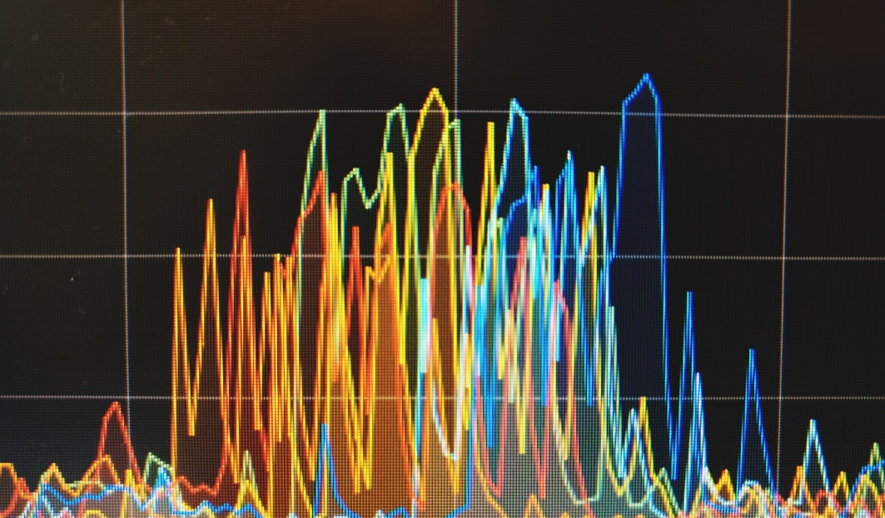
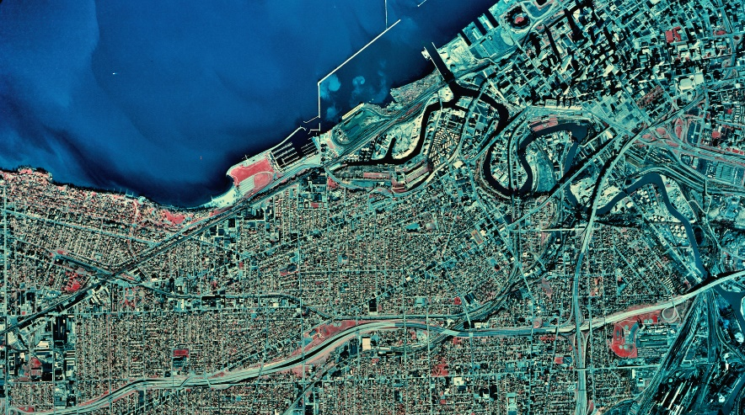
Machine learning deployed today
Telemetry Outlier Detection
Geospatial Analytics

Slide 4
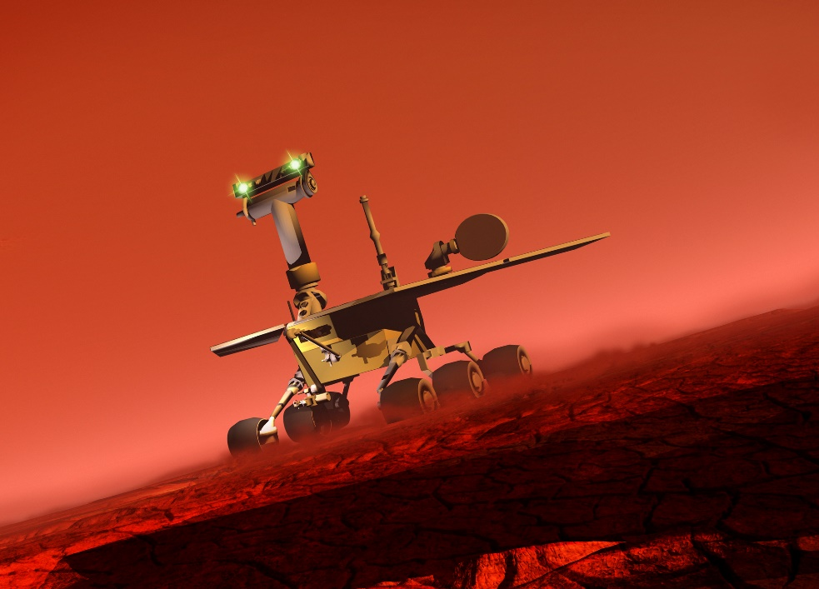
What’s next?
Relative navigation
Autonomous decision making logic
On-board fault detection
And more…

Slide 5
Artificial Intelligence
Artificial Intelligence
The capability of a machine to imitate intelligent human behavior

Slide 6
Machine Learning
Artificial Intelligence
Uses computational methods to “learn” information directly from data without assuming a predetermined equation as a model
Machine Learning

Slide 7
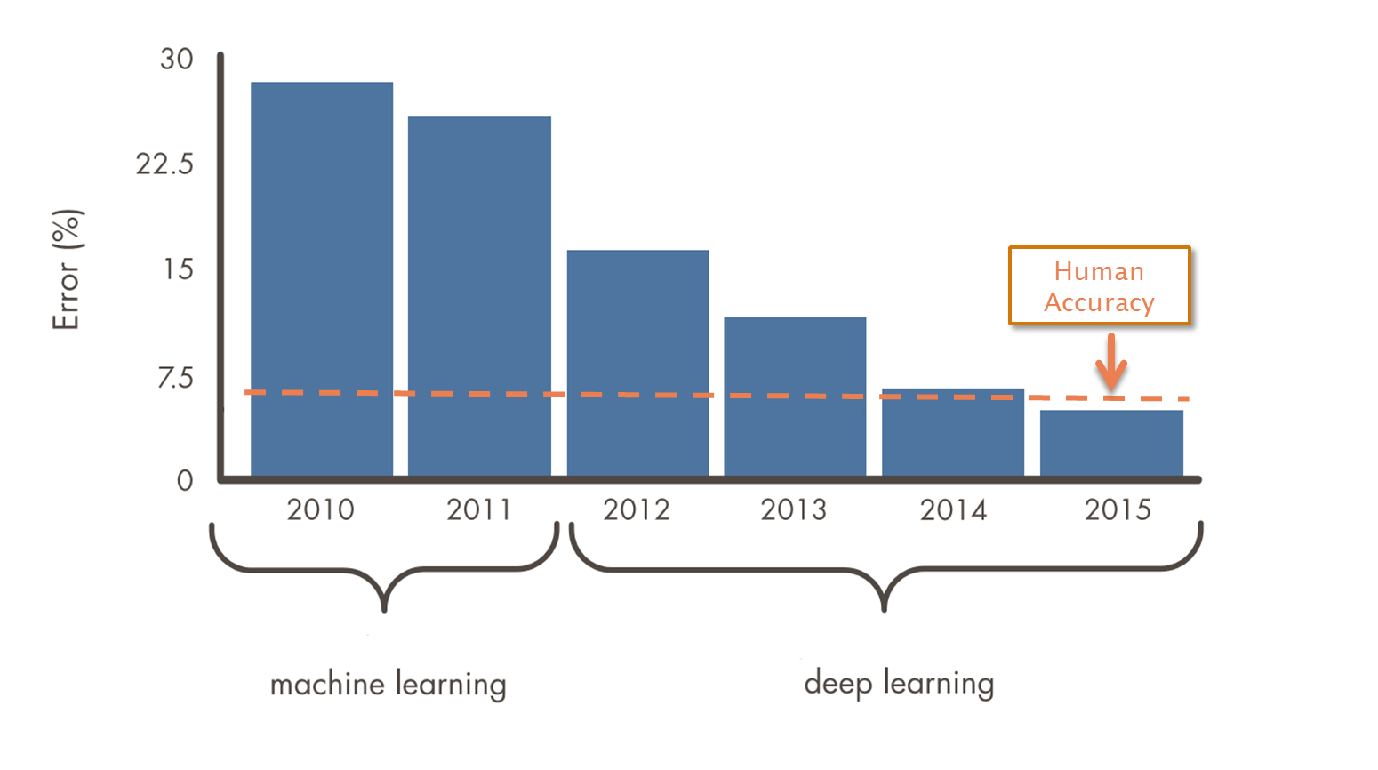
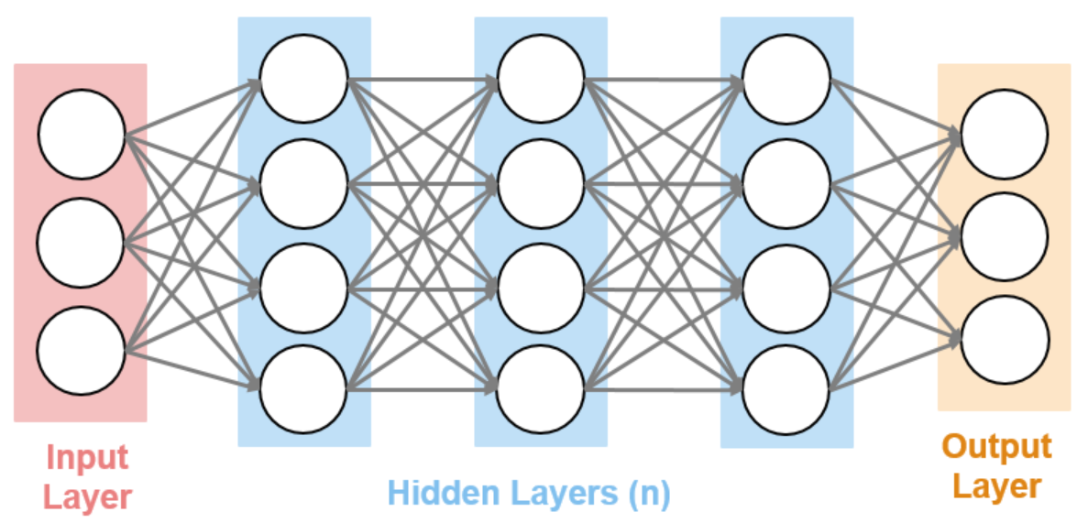
Deep Learning
Artificial Intelligence
A subset of machine learning usually associated with neural networks
Machine Learning
Deep Learning
Source: ILSVRC Top-5 Error on ImageNet

Slide 8
There are two ways to get a computer to do what you want
Traditional Programming
Data
COMPUTER
Output
Program

Slide 9
There are two ways to get a computer to do what you want
Machine Learning
Data
COMPUTER
Program
Output

Slide 10
There are two ways to get a computer to do what you want
Machine Learning
Data
COMPUTER
Model
Output

Slide 11
There are two ways to get a computer to do what you want
Data
EMBEDDED DEVICE
Model
Output

Slide 12
Types of Machine Learning
Type of Learning
Categories of Algorithms
Classification
Output is a choice between classes (True, False) (Red, Blue, Green…)
Supervised Learning
Regression
Output is a real number (Attitude, Velocity, Temperature…)
Develop predictive model based on both input and output data
Machine Learning
Unsupervised Learning
finds natural groups and patterns from input data only
Clustering
Discover an internal representation from input data only

Slide 13
The Role of AI in Your System
?
AI model

Slide 14
The Role of AI in Your System
Caffe
Access Data
Analyze Data
Develop
Deploy
Sensors
Data exploration
AI model
Specialized apps
Files
Preprocessing
Algorithm development
Ground systems
Databases
Domain-specific algorithms
Modeling & simulation
On-board embedded devices

Slide 15
What can the AI model do?
?

Slide 16
What should the AI model do?
ConOps,
Mission Plan
(Why?)
?
WISDOM
Supervisory Logic,
Rules
(How?)
KNOWLEDGE
Sensing,
State Estimation
(What? Where?)
INFORMATION
Raw inputs
DATA

Slide 17
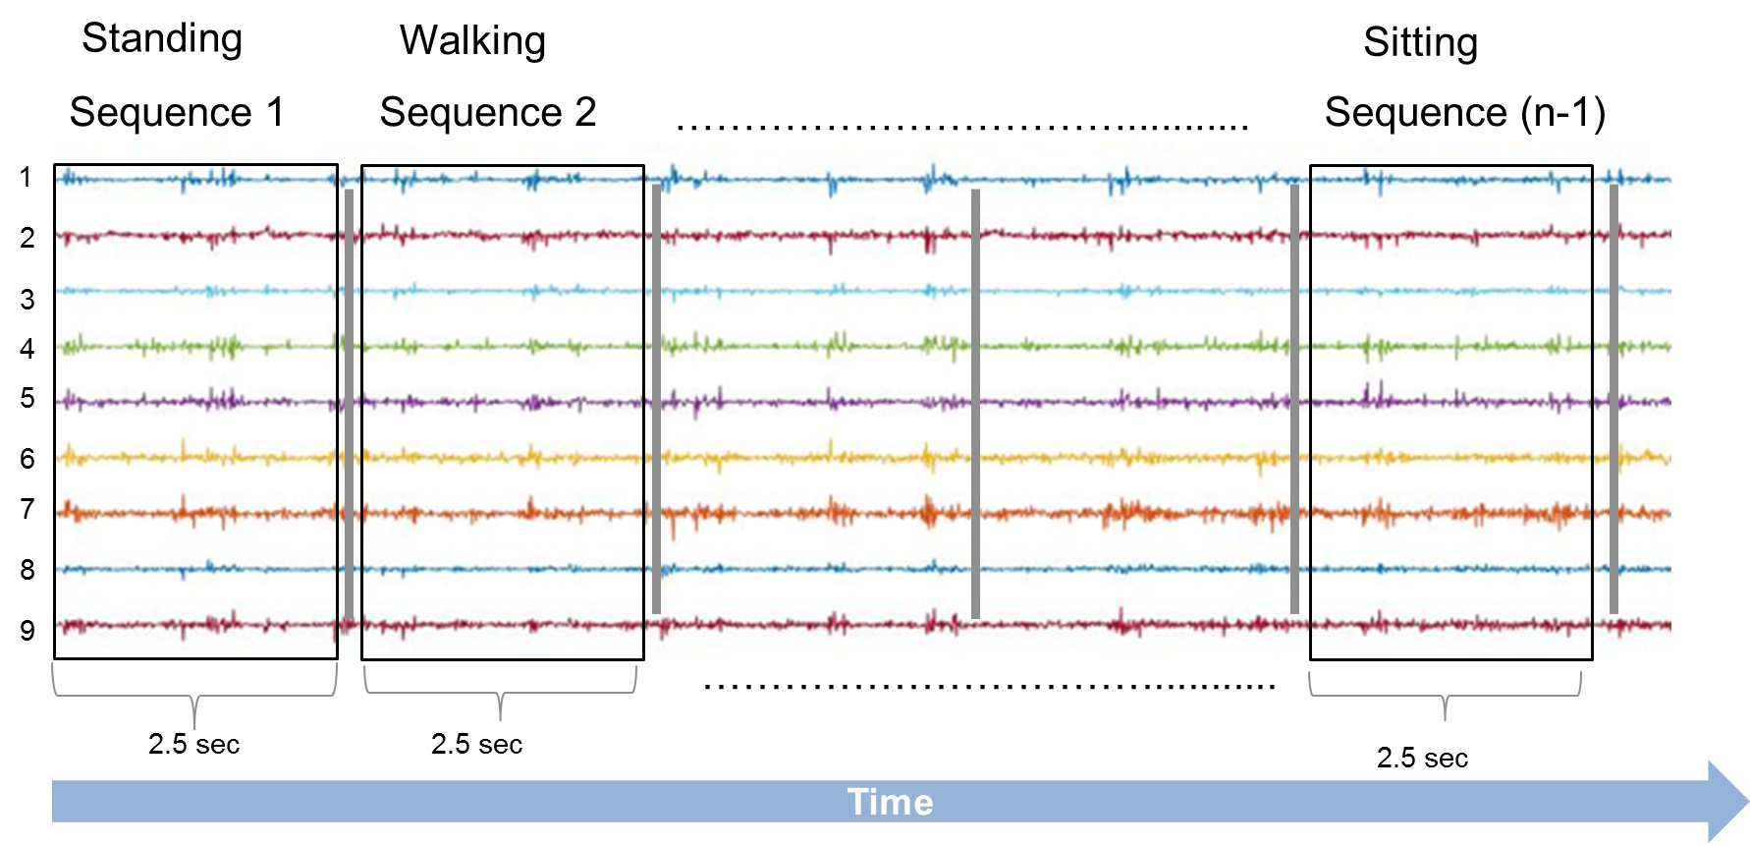
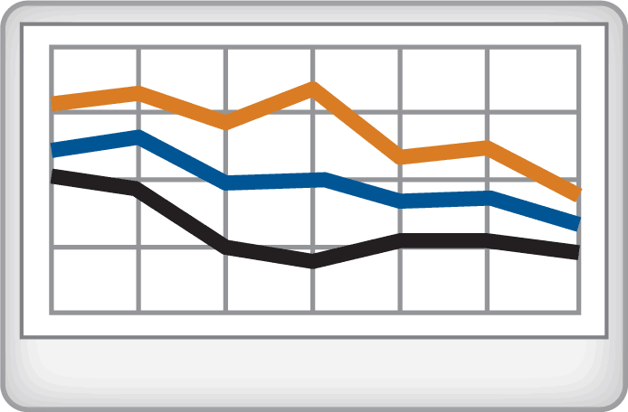
Example: Analyzing signal data using deep learning
Deep Learning

Slide 18
Example: Analyzing signal data using deep learning
Deep Learning
Time Series Classification

Slide 19
Example: Analyzing image data using deep learning
Object detection and localization
Semantic segmentation

Slide 20
Key Enablers for Machine Learning
COMPUTING POWER
DATA
ALGORITHMS

Slide 21
Challenges
Space-rated hardware lags the leading edge
Less data available from deep space
How to verify machine learning algorithms?

Slide 22
How to verify machine learning algorithms?
Black box testing to statistical requirements
Randomized test input
(full mission envelope)
ML model
Verify output meets
requirements

Slide 23
How to verify machine learning algorithms?
Sanity checking
ML model
Sanity Checking Logic
SYSTEM
Fully deterministic algorithm
100% test coverage on sanity checking logic

Slide 24
How to verify machine learning algorithms?
Dissimilar redundancy
ML model
Voting Logic
SYSTEM
Same functionality
“Traditional” algorithm
Fully deterministic algorithm
100% test coverage on logic

Slide 25
How to verify machine learning algorithms?

Slide 26
How to verify machine learning systems?

Slide 27
Most likely near-term use cases in space
Lenient hardware survivability requirements: short duration missions
Available training data: LEO, lunar applications
Risk tolerance: low cost programs / low risk applications

