Slide 1

Provably Safe Pointers for a Parallel World
Flight Software Workshop, December 2018
San Antonio, TX
Presented by:
Stephen Baird
Senior Software Engineer, AdaCore

Slide 2
Why Try to Verify Use of Pointers?
Trying to reduce entry barriers to use of formal methods in industry, such as that provided by SPARK 2014
Many complex, dynamic data structures depend on some notion of re-assignable pointers
As is, SPARK forces users to make creative use of arrays instead
  Because… unrestricted use of pointers is notoriously hard to formally verify
How to Verify use of Pointers:
  Separation Logic is one approach, but a challenge for industrial programmers to produce the annotations needed for proof
  Some variant of Pointer ownership is a viable alternative

Slide 3
What is the SPARK 2014 Language?
SPARK 2014 is a multiparadigm (OO, FP, RT, MP) programming and specification language designed for formal verification using deductive proof.
SPARK 2014 provides a subset of Ada 2012 run-time semantics, with additional design-time formalisms to support information flow analysis and proof.
SPARK is supported by a set of commercial tools and has been used to formally verify large real-time systems.
Main SPARK restrictions relative to Ada 2012:
  No exception handlers
  No (re-assignable) pointers – topic of this talk

Slide 4
SPARK 2014 – Commercial Tools
SPARK code can be combined with Ada, C, C++ code
SPARK code is marked specially to indicate where extra checking should be performed (at unit/subprogram level)
GNAT compiler
  compiles Ada, SPARK, C, and C++ code, including contracts and “ghost” code
  checks SPARK legality rules where SPARK mode is specified
GNATprove formal verification tool
  checks SPARK verification rules by flow analysis and proof
  reports useful information on failed proofs (code paths, counterexamples)
IDEs (GPS/GNATbench) integrate all tools

Slide 5
Existing Goals for SPARK Formal Verification
Verify that code implements the specification
Implicit specifications | User defined specifications
No reads of uninitialized data No run-time errors No deadlocks, no data races | Information Flow and Data Dependences as expected Functional contracts obeyed (pre/post/invariant) API/Integration contracts obeyed (pre, predicates)

Slide 6
Formal Verification in SPARK
Properties Proved
Correct initialization
Correct data dependencies
Safe concurrent access
Program Dependence Graph (PDG) => Flow Analysis
Properties Proved
Absence of run-time errors
Functional contracts proved
Safety/security properties
∃x. P(x) ⟹
¬∀x. ¬ P(x)
Verification Conditions (VC) => SMT Solvers

Slide 7
SPARK 2014 Methodology
Progressive adoption with incremental benefits relative to effort
SPARK can be used as:
  Main programming language (green field); or
  Re-implementing/kernelizing most critical part of codebase originally in, e.g., C, C++, or Ada (brown field)
Useful to think in terms of levels:
  Stone level – coding standard checking for language subset
  Bronze level – initialization and correct data flow
  Silver level – absence of run-time errors
  Gold level – proof of key integrity properties
  Platinum level – proof of functional correctness

Slide 8
Formal verification level goal
circle size = amount of code
Enforcing a strong coding standard
Correct
initialization
and data dependencies
Absence of run-time errors
Safety and
security
properties
Stone
Bronze
Silver
Full Functional
Correctness
Gold
Pt

Slide 9
Examples of industrial practice with SPARK
Certification Standard | DO-178, DEFSTAN 00-55 | CAP670 SW01 | Common Criteria GCHQ Standards
Certification level | DO-178 level A, DEFSTAN SIL4 |  | NSA Type 1 Secret
Typical analysis level | Bronze/Silver/Gold | Silver | Silver/Gold
Example projects | Typhoon, SHOLIS, C130J | iFACTS | Turnstile, Muen, MLW
Example customers | Rolls-Royce, Lockheed Martin | NATS | Rockwell Collins, Secunet, MBDA

Slide 10
Goals for Pointer Safety in a Parallel World
No null pointer dereferences: No null pointer is dereferenced
Proper ownership: Every heap object has well-defined “owning” pointer, at least at certain critical times:
  No storage leaks: When owner is set to null, the heap object is reclaimed immediately – no need for asynchronous garbage collector
  No dangling references: Owner may be set to null (and cause reclamation) only when it is the only pointer with access to the heap object
No Hidden Aliasing: So can verify correctness of algorithm
  Exclusive write: At most one pointer gives read/write access to any given heap object at a time
    When such a pointer exists, no pointers giving read-only access may exist
  Concurrent read: One or more pointers may give read-only access to a given heap object at a time
    Owning pointer gives strictly read-only access whenever such pointers exist
    Transitivity: Pointer in read-only heap object gives strictly read-only access

Slide 11
Pointer “Ownership-based” Approach
Alternative to Separation Logic.
Amenable to Deductive Proof.
Supports:
  Full ownership (exclusive read/write access); or
  Partial/Shared ownership (concurrent read-only access)
Generalizes the guarantees against aliasing already required by (pointer-free) SPARK w.r.t. by-reference parameter passing, namely:
  Must not pass a (writable) global as a by-reference parameter
  Must not pass same object twice as a by-reference parameter, if either is writable

Slide 12
Challenges with Pointer Ownership Model
Pointer ownership supports tree-ish data structures:
  Trees (ordered sets), Linked lists, Extensible vectors, Hash tables (hashed sets and maps)
What about graphs or doubly linked lists?
  Can use arrays or maps of Nodes, Indexed by Node Id
  Maps/Arrays are sufficient because Nodes themselves can be tree-ish structures using, e.g. (lists of) Node Ids to represent edges to predecessors/successors
  Even when pointers are unrestricted, graph edges are often represented otherwise (e.g. with node ids)

Slide 13
Aside: “Reference” vs. “Pointer”
Reference
Pointer
Reference acts as an alias for an existing object
Reference refers to same object throughout its life
Assignment with Reference as LHS updates Target Object
Anti-aliasing rules may be necessary for by-reference parameters
Pointer is a separate, assignable object that designates a pre-existing object, or is null
Assignment with Pointer as LHS changes where it points, or sets it to null
“Safe Pointer” rules make restrictions on where pointer may point, number of pointers to same object, etc.

Slide 14
More challenges: Walking a tree when Pointers are “owning”
Need a notion of a “secondary” reference to “walk” a tree pointed to by an “owning” pointer
Need two kinds of tree walkers:
  Walker that gives read-only access to tree
    We call this an “observer”
  Walker that gives read-write access to tree
    We call this a “borrower,” because it temporarily becomes the owner of (some part of) the tree

Slide 15
Final Challenge: Define ownership-based pointer feature as subset of existing language
SPARK’s dynamic semantics are a subset of Ada
Ada has pointers and exceptions, but SPARK has neither
Ada’s pointers have some pointer-type-based restrictions to reduce dangling references, but rely on programmer to decide when safe to reclaim heap object (“Unchecked Deallocation”)
Ada implementations are allowed to do garbage collection, but only VM-based implementations do so.
Garbage collection is hard to certify in hard real-time environment where Ada is most widely used.

Slide 16
Vocabulary for operations on pointers
Move a name – Move RHS to LHS; reclaim old LHS and replace; null-out RHS
Chosen syntax: LHS := RHS; -- debatable!
Copy a name – Copy RHS; reclaim old LHS and replace with deep copy
Chosen syntax: LHS := RHS’Copy;
Borrow a name – Temporarily transfer ownership from RHS to LHS
Chosen syntax: declare … LHS : access T := RHS;
Observe a name – Temporarily create shared observer of RHS in LHS
Chosen syntax: declare … LHS : access constant T := RHS;
Notes:
Need rules to make sure same object is not passed as in-out parameter twice.

Slide 17
Rules for operations on pointers
=> preserve concurrent reader, exclusive writer (CREW) model
Move a name – Move RHS to LHS; reclaim old LHS and replace; null-out RHS
  RHS and LHS must be neither observed nor borrowed; RHS and LHS must be variables
Copy a name – Copy RHS; reclaim old LHS and replace with copy
  LHS must be a variable that is neither observed nor borrowed; RHS temporarily frozen
  ‘Copy automatically constructed by default, but can be overridden on a per-type basis
Borrow a name – Temporarily transfer ownership from RHS to LHS
  LHS is new object; RHS must be neither observed nor borrowed.
  Three ways to create borrower, which is always a newly declared object/name:
    Initialize an access-to-variable object (owning access object) of an anonymous type (including a parameter)
    Rename a part of a dereference of an owning object that is in an unrestricted state
    Pass a composite object as [in] out with a subcomponent that is an owning access object
  “Borrowed” state of RHS lasts for scope of borrower object
Observe a name – Temporarily create shared observer of RHS in LHS
  LHS is new object; RHS gives up read-write access (if it has it) when observer is created
  Two ways to create an observer, which is always a newly declared object/name:
    Initialize an access-to-constant object (observing access object) from existing access-to-variable reference
    Pass a composite object as an in parameter with a subcomponent that is an owning access object
  “Observed” state of RHS lasts for scope of observer object
Notes:
Need rules to make sure same object is not passed as in-out parameter twice.

Slide 18
Rules for operations on pointers
Move a name – Move RHS to LHS; reclaim old LHS and replace; null-out RHS
  Assign to an access-to-variable object (owning access object) of a named type
  RHS and LHS must not be observed nor borrowed; RHS and LHS must be variables
  Side-effect of “move” is to null out “moved” (RHS) name and finalize/deallocate former LHS designee (if not “self” move)
Copy a name – Copy RHS; reclaim old LHS and replace with copy
  Use the ‘Copy attribute, as in: Y := X’Copy;
  LHS must be a variable that is neither observed nor borrowed
  ‘Copy automatically constructed by default, but can be overridden on a per-type basis
Borrow a name – Temporarily transfer ownership from RHS to LHS
  Initialize an access-to-variable object (owning access object) of an anonymous type (including a parameter)
  Rename a part of a dereference of an owning object that is in an unrestricted state
  Pass a composite object as [in] out with a subcomponent that is an owning access object
  “Borrowed” state lasts for scope of borrower object
Observe a name – Temporarily create shared observer of RHS in LHS
  Initialize an access-to-constant object (observing access object) from existing access-to-variable reference
  Pass a composite object as an in parameter with a subcomponent that is an owning access object
  “Observed” state lasts for scope of observer object
Notes:
Need rules to make sure same object is not passed as in-out parameter twice.

Slide 19
Example – Reverse last two elements of list -- is this safe?
type List;
type List_Ptr is access List with Ownership;
type List is record -- Ownership implicitly True
Next : List_Ptr;
Data : Data_Type;
end record;
procedure Swap_Last_Two (X : in out List_Ptr) is
-- Swap last two elements of list
begin
if X = null or else X.Next = null then -- < 2 elems
return;
else if X.Next.Next = null then -- exactly 2 elems
declare
Second : List_Ptr := X.Next;
begin
X.Next := null;
Second.Next := X; -- swap them
X := Second;
end;
else -- > 2 elems
declare
Walker : access List := X;
begin
while Walker /= null loop
declare
Next_Ptr : List_Ptr renames Walker.Next;
begin
if Next_Ptr /= null
and then Next_Ptr.Next /= null
and then Next_Ptr.Next.Next = null
then
-- Found second-to-last element
declare
Last : List_Ptr := Next_Ptr.Next
begin
-- Swap last two
Next_Ptr.Next := null;
Last.Next := Next_Ptr;
Next_Ptr := Last;
return; -- All done
end;
end if;
end;
-- Go to next element
Walker := Walker.Next;
end loop;
end;
end if;
end Swap_Last_Two;
Storage Leaks?
Dangling Refs?
Null Ptr Derefs?
Circularly Linked?
Correct Result?

Slide 20
Vocabulary for ownership-based pointers
Ownership aspect (Boolean)
  Specifiable for named pool-specific access types, anonymous stand-alone access objects, by-ref composite and private types
Owning access type, Owning access object -- provides read/write access
  Access-to-variable type with Ownership True
Observing access type, Observing access object -- provides read-only access
  Access-to-constant type with Ownership True
Ownership States of object names
  Unrestricted -- Default state of static name, unless access-to-constant or subcomponent of a constant
  Observed -- Default state for an access-to-constant object or subcomponent of a constant
    Also becomes “observed” after being used to initialize an “observing” access object
  Borrowed -- After being used to initialize some other owning access object
  Dynamic Ownership State – Default state of dynamic name that is not in observed or borrowed state
Managed object
  All of the above, plus any part of a dereference of an owning or observing access object

Slide 21
Vocabulary about names involving pointers
Static name (of an object)
  Name that statically denotes an entity
  Dereference of static prefix being of an access type with Ownership True
  Selected component of static prefix
  Name that denotes a renaming where renamed entity denoted by static name
Dynamic name (of an object)
  Indexed component
  Slice
  Dereference of an access type with Ownership False
  Name with a dynamic name as prefix
Two names are Statically Overlapping if they are both static and denote the same object, or one is static and matches a prefix of the other
Two dynamic names are Potential Aliases if they are the same ignoring dynamic indexing and slicing, or are aliased and of same type with at least one being a dereference of an access type with Ownership False
Two dynamic names are Potentially Overlapping if they are Potential Aliases, or either is a Potential Alias of a prefix of the other

Slide 22
Example – Reverse Last two elements of list
type List;
type List_Ptr is access List with Ownership;
type List is record -- Ownership implicitly True
Next : List_Ptr;
Data : Data_Type;
end record;
procedure Swap_Last_Two (X : in out List_Ptr) is
-- Swap last two elements of list
begin
if X = null or else X.Next = null then -- < 2 elems
return;
else if X.Next.Next = null then -- exactly 2 elems
declare
Second : List_Ptr := X.Next;
begin
X.Next := null; -- not really necessary
Second.Next := X; -- swap them
X := Second;
end;
else -- > 2 elems
declare
Walker : access List := X;
begin
while Walker /= null loop
declare
Next_Ptr : List_Ptr renames Walker.Next;
begin
if Next_Ptr /= null
and then Next_Ptr.Next /= null
and then Next_Ptr.Next.Next = null
then
-- Found second-to-last element
declare
Last : List_Ptr := Next_Ptr.Next;
begin
-- Swap last two
Next_Ptr.Next := null; -- not really necessary
Last.Next := Next_Ptr;
Next_Ptr := Last;
return; -- All done
end;
end if;
end;
-- Go to next element
Walker := Walker.Next; -- OK to borrow in subtree
end loop;
end;
end if;
end Swap_Last_Two;
Key:
Move
Borrow
Borrowed
Storage Leaks?
Dangling Refs?
Null Ptr Derefs?
Circularly Linked?
Correct Result?

Slide 23
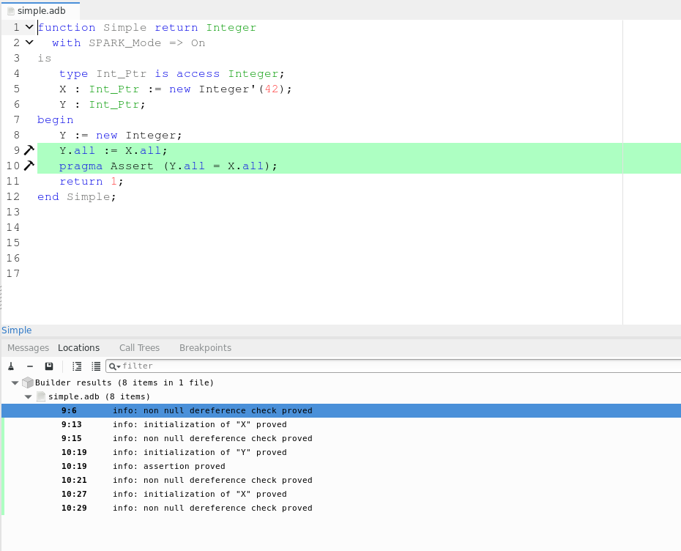
Example of SPARK
IDE

Slide 24
Example – Insert into Hashed Set
type Node;
type Node_Prtr is access Node with Ownership;
type Node is record -- Ownership implicitly True
Next : Node_Ptr;
Key : Key_Type;
end record;
type Node_Ptr_Array is array (Positive range <>) of Node_Ptr;
type Hashed_Set (Size : Positive) is record
Backbone : Node_Ptr_Array (1 .. Size);
end record;
type Hashed_Set_Ptr is access Hashed_Set;
procedure Include (HS : in out Hashed_Set_Ptr;
Key : Key_Type) is
-- insert into Hashed Set if not already there
begin
if HS = null then
HS := new Hashed_Set (Default_Initial_Size);
end if;
declare
Index : constant Positive :=
Hash (Key) mod HS.Size + 1;
Ptr : access constant Node :=
HS.Backbone (Index);
begin
while Ptr /= null loop
if Equiv (Key, Ptr.Key) then
-- Already in set, just return
return;
end if;
Ptr := Ptr.Next; -- OK to Observe within subtree
-- Ptr := HS.Backbone (J): -- Illegal to observe outside
end loop;
end; -- Ptr ”observing” ends here
-- Not in set, create a new Node and move into
-- front of appropriate bucket
-- This involves two moves with HS.Backbone(I) being
-- null in between the two moves
HS.Backbone (Index) :=
new Node’(Next => HS.Backbone (I),
Key => Key);
end Include;
Key:
Move
Observe
Observed
Storage Leaks?
Dangling Refs?
Null Ptr Derefs?
Circularly Linked?
Correct Result?

Slide 25
Relation to Safe Parallelism
Anti-Aliasing Rules
Pointer Ownership Rules
Data-Race Prevention
Must not pass a (writable) global as a by-reference parameter
Must not pass same object twice as a by-reference parameter, if either provides read/write access
One or more pointers giving read-only access, and no writers
Exactly one pointer giving read-write access, and no readers
One or more threads having read-only access and no writers
Exactly one thread having read-write access, and no readers

Slide 26
Provably Safe Pointers are Practical
Pointer Ownership provides sound, understandable, and safe alternative to Separation Logic for verifiable industrial use of pointers
Parallelism safety checks are natural extension of anti-aliasing and ownership checks
Pointer-based structures are more important as critical systems grow in complexity and dynamism

Slide 27
Questions?

