Slide 1
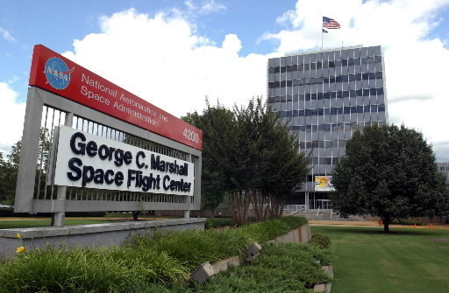
Join us at the 12th Annual Flight Software Workshop!
December 9-12, 2019
NASA Marshall Space Flight Center
Huntsville, Alabama

