Slide 1
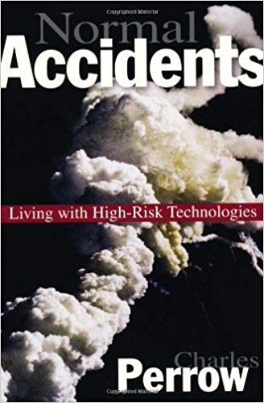
Normal Accidents: Living with High-Risk Technologies Charles Perrow
Conventional engineering approach to ensuring safety, building in more warnings and safeguards, fails because systems complexity makes failures inevitable
Book asserts that typical precautions, by adding to complexity, may help create new categories of accidents.
Alan Unell gives it 5 stars and 2 thumbs up!

Slide 2
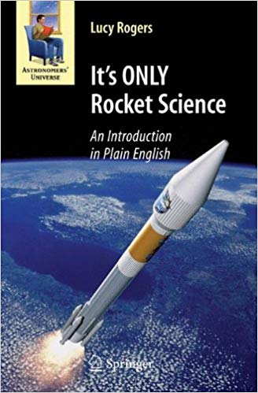
It's ONLY Rocket Science: An Introduction in Plain English Lucy Rogers
The beauty of this book, written by an engineer who is also an accomplished science writer, is that it covers the subject comprehensively, and yet is almost entirely descriptive and non-mathematical
It deals with all aspects of space flight, from how to leave the Earth, to life in space and the effects of weightlessness
Dr. Rogers is a Fellow of the Institution of Mechanical Engineers, judge, on BBC Robot Wars, and founder of the Guild of Makers, and help hack a park of animatronic dinosaurs

