Slide 1
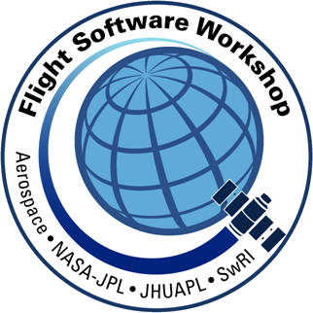
DevOps for Planetary Defense Flight Software
11th Workshop on Spacecraft Flight Software
Justin Thomas
Embedded Applications Group
Space Exploration Sector
December 6, 2018
DART Team Contributors:
Chris Heistand
Andrew Badger
Austin Bodzas
Luis Rodriguez
Nigel Tzeng
Aaron Dalton
Jesse Pai
Derik Thompson
This is a non-ITAR presentation, for public release and reproduction from FSW website.

Slide 2
Outline
Introduction
DART Mission
Underlying Philosophy
Development Environment
Automated Testing
Development Workflow
Case Study: NEXT-C Thruster
Summary

Slide 3
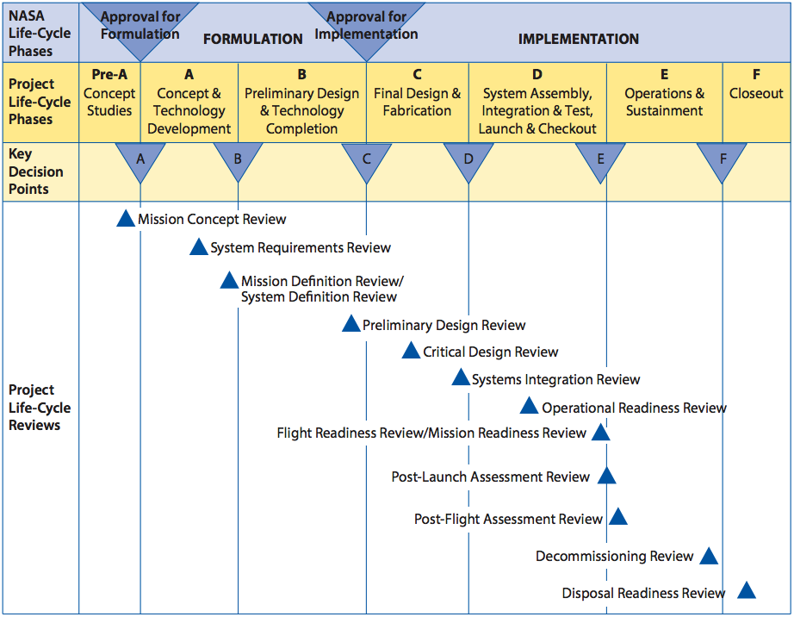
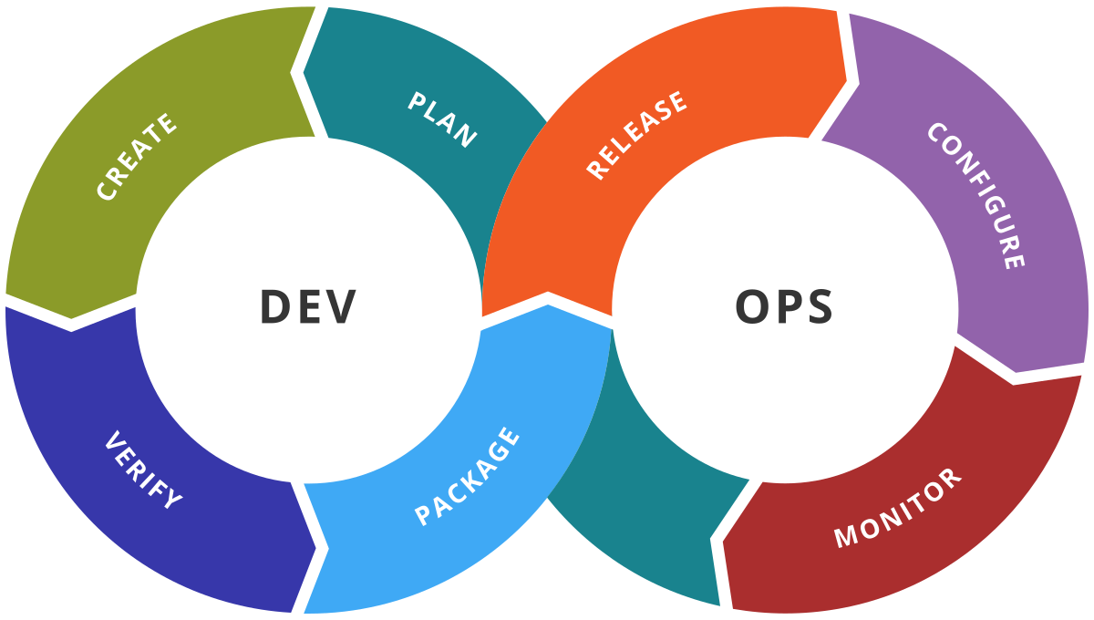
Motivation
Web Dev
FSW
Dev

Slide 4
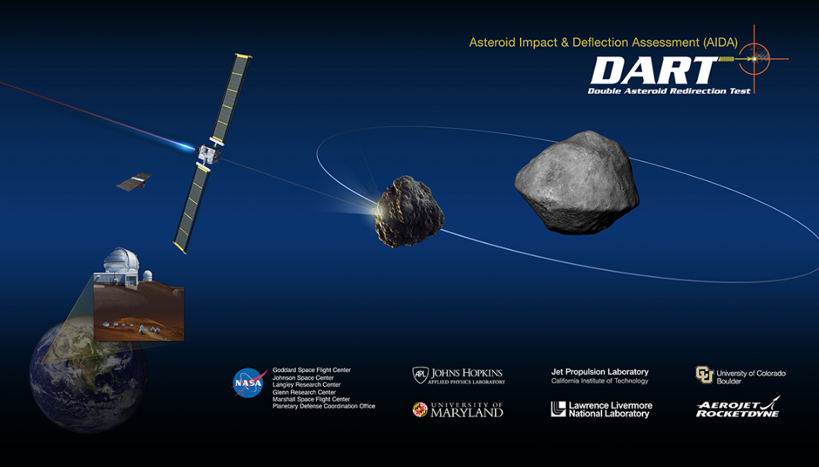
DART Mission

Slide 5
Propulsion
  NEXT-C, 2 Axis Gimbal
  Single Throttle Level – TL28 (3.5 kW)
  Monoprop Hydrazine Blow-down
Power
  22 m² Roll-out Solar Arrays, Single Axis Drive
Attitude Control System
  5 Sun Sensors, 1 Star Tracker, 1 Inertial Measurement Unit
  Thruster-Only Attitude Control
Communications
  X-Band, 2 Low Gain Antennas for near-full-sky
  1 High Gain Antenna with Single Axis Gimbal
Payload:
  DRACO Telescope (New Horizons LORRI Heritage)

Slide 6
Underlying Philosophy
Small Bites
DevOps
Fail Fast
Flexible Source Control
Use the right tools

Slide 7
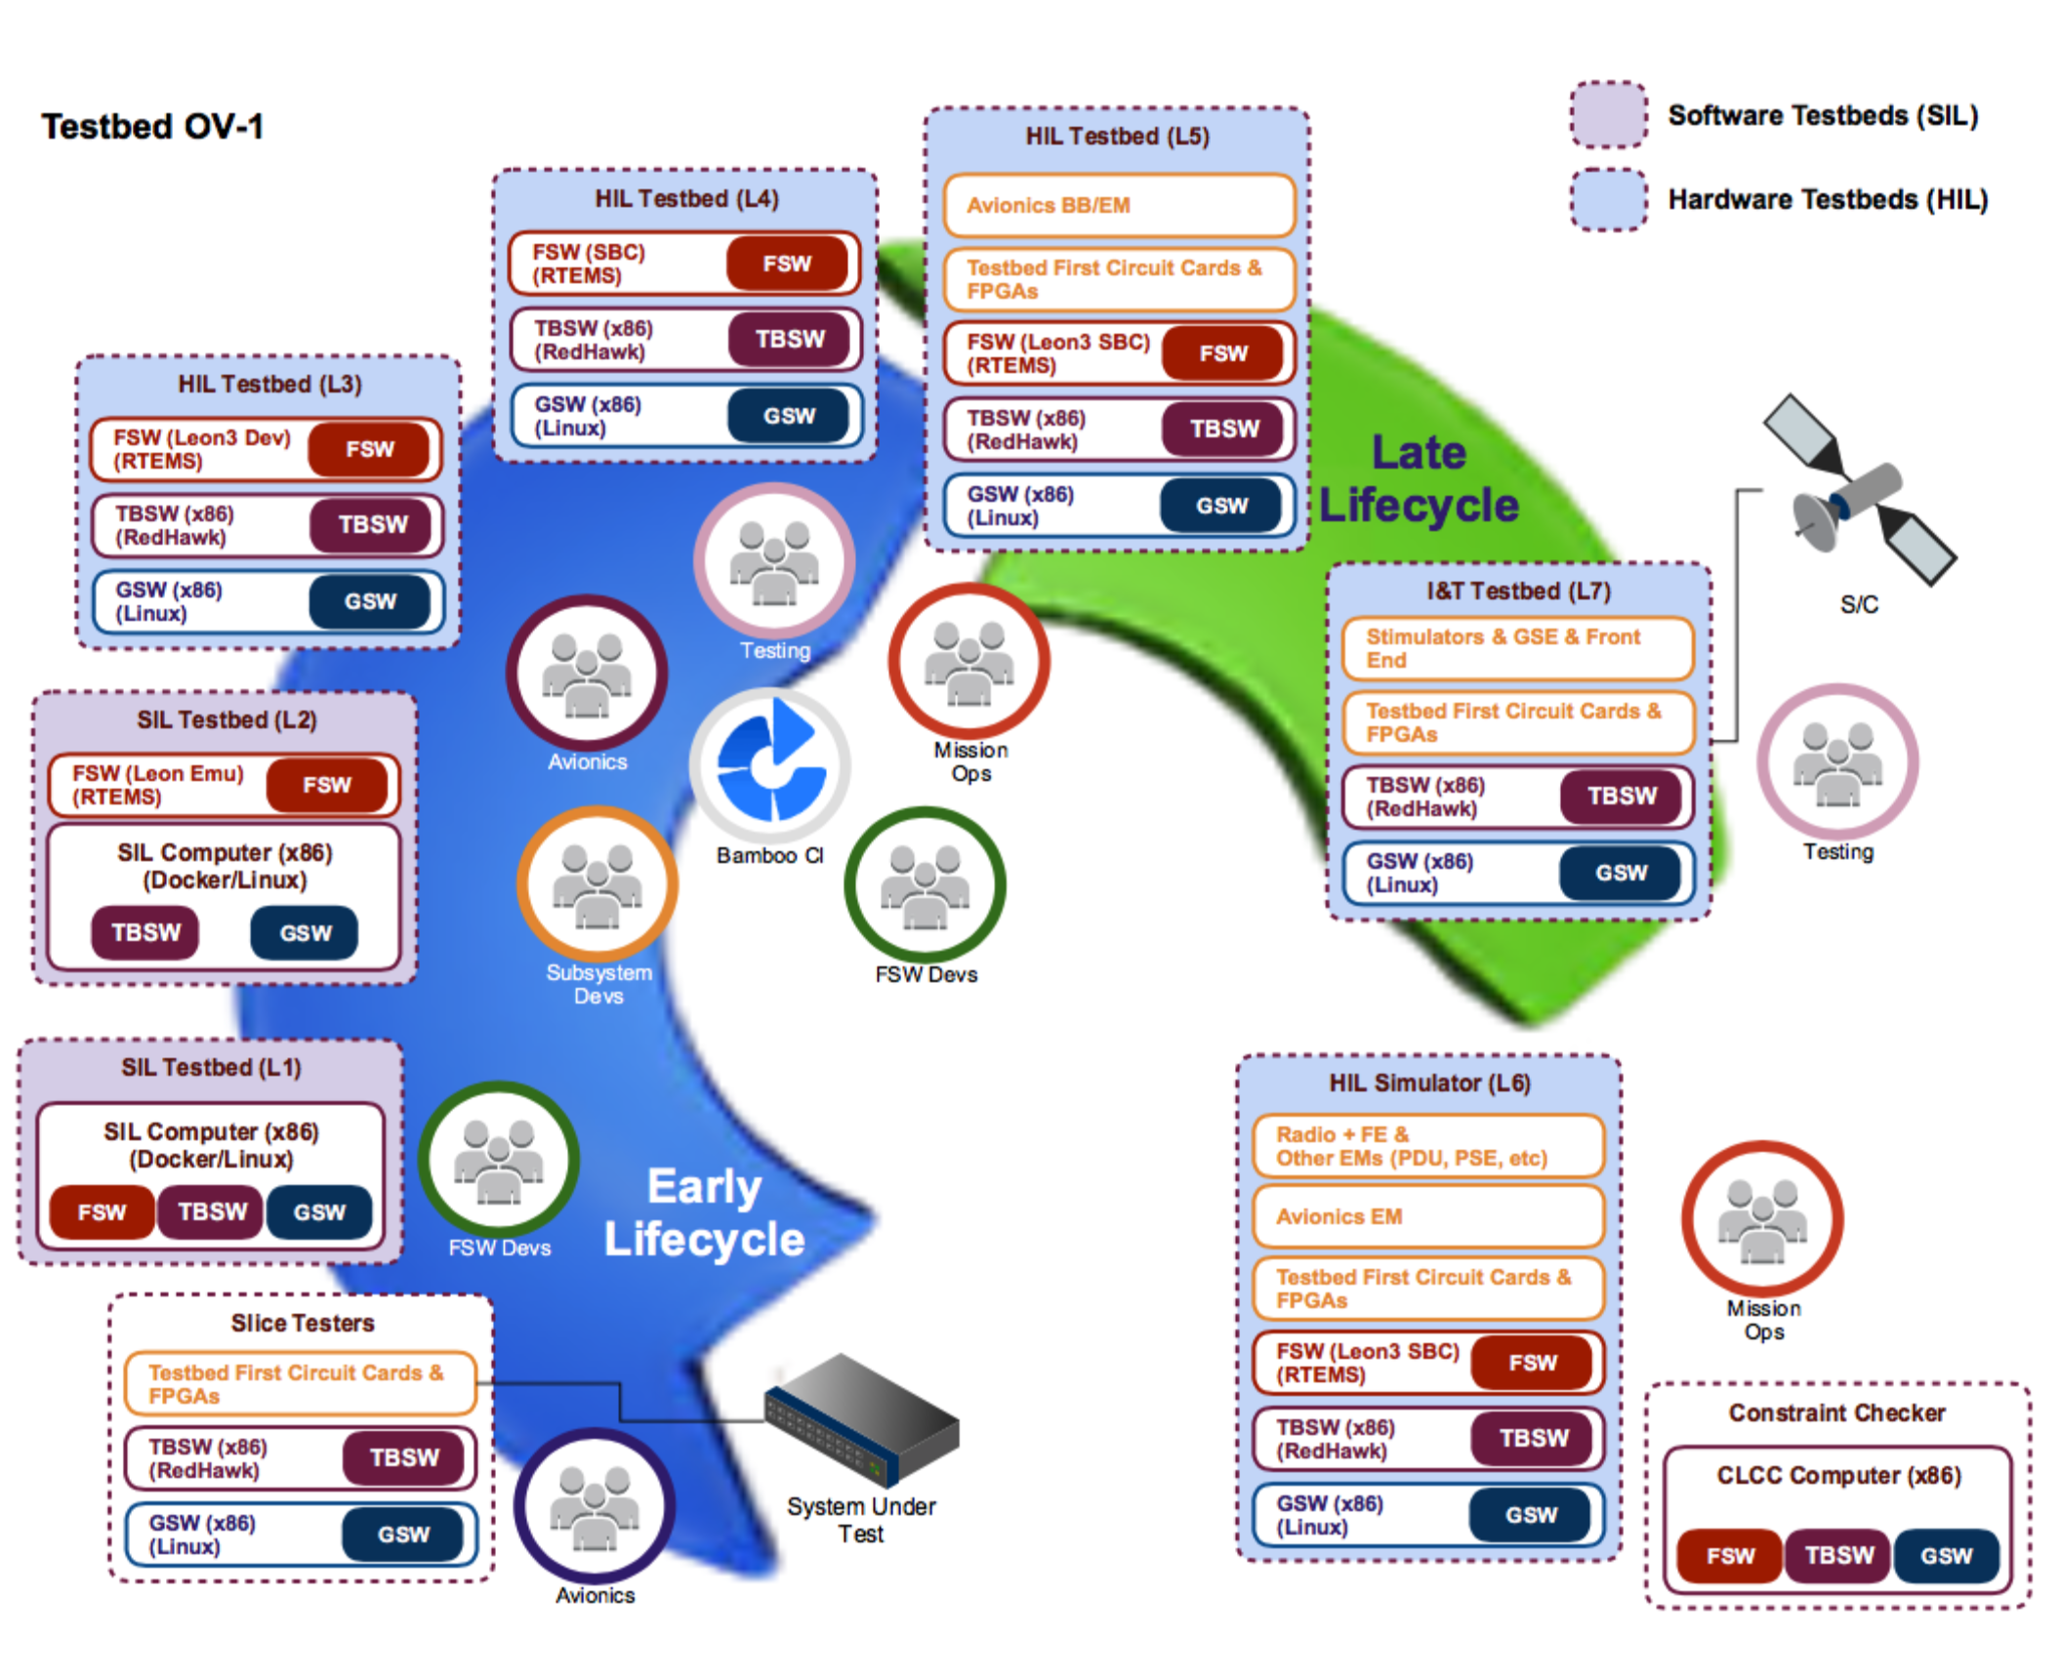
Development Environment
Hardware in the Loop (HWIL) Testbeds
Software-in-the-Loop (SWIL) Testbeds
Flight Software (FSW) Development Tools

Slide 8
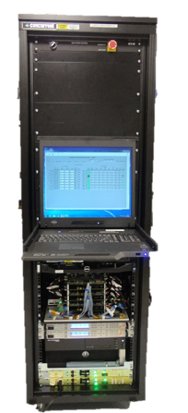
Development Environment
Hardware in the Loop (HWIL) Testbeds
Avionics + Real Time Simulator

Slide 9
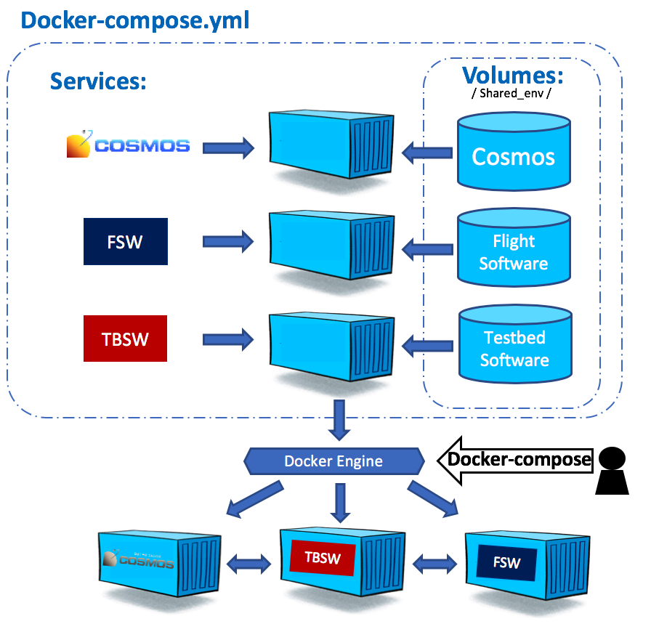
Development Environment
Software in the Loop (SWIL) Testbeds
Core Flight Executive (cFE)
  PC-Linux Target
Docker

Slide 10
Development Environment
Flight Software (FSW) Development Tools
RTLog
Eclipse Visual Debug + Docker Tooling
LTTng (SWIL)

Slide 11
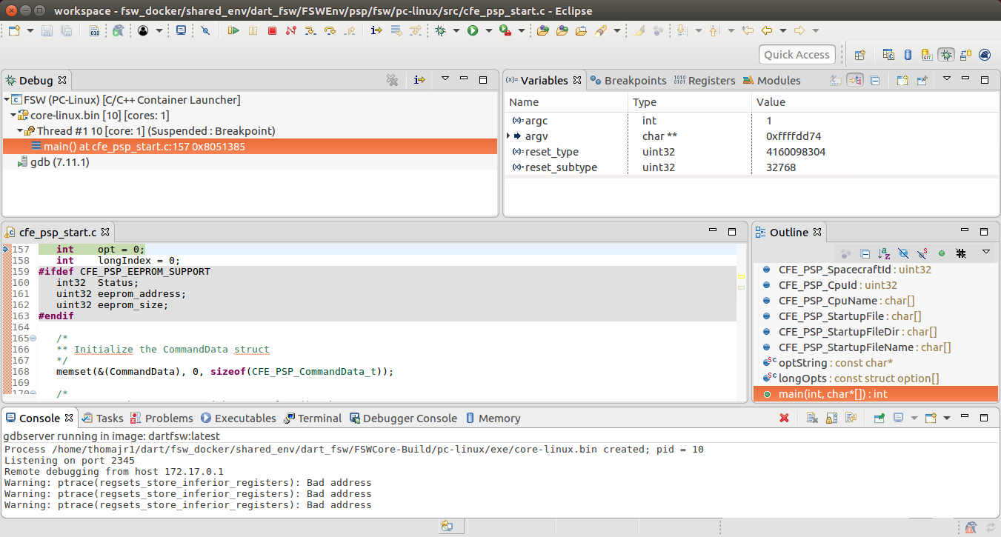
Development Environment
Flight Software (FSW) Development Tools – Eclipse Visual Debug

Slide 12
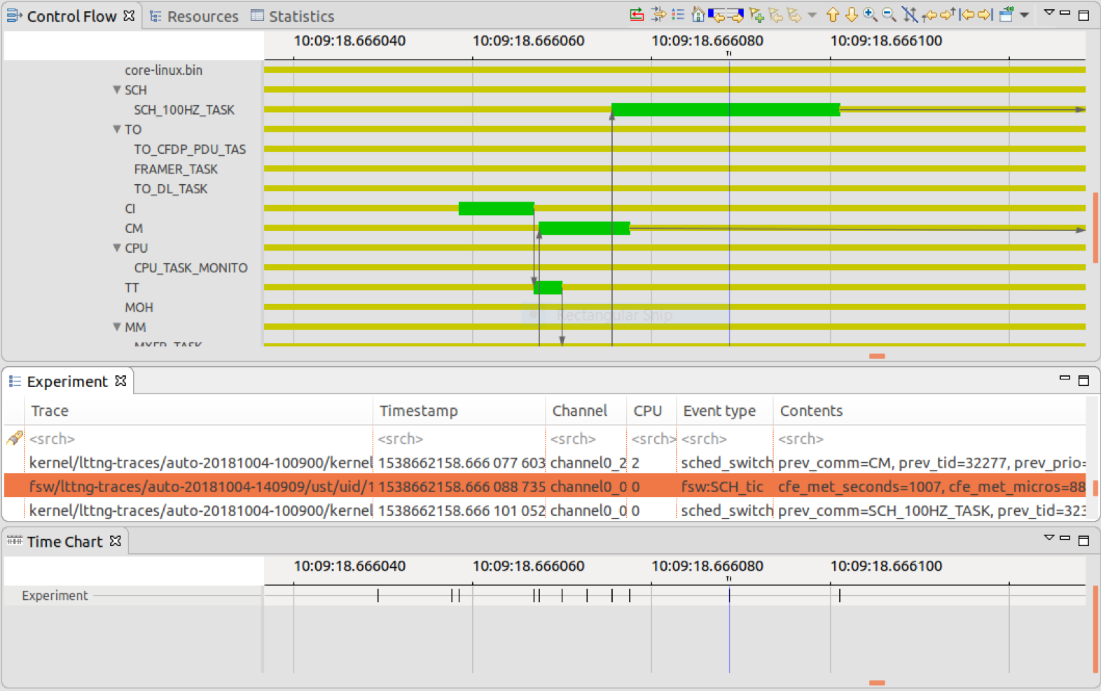
Development Environment
Flight Software (FSW) Development Tools – LTTng

Slide 13
Automated Testing
Unit Test
Application Test
System Test
Automated Reviews and Assurance

Slide 14
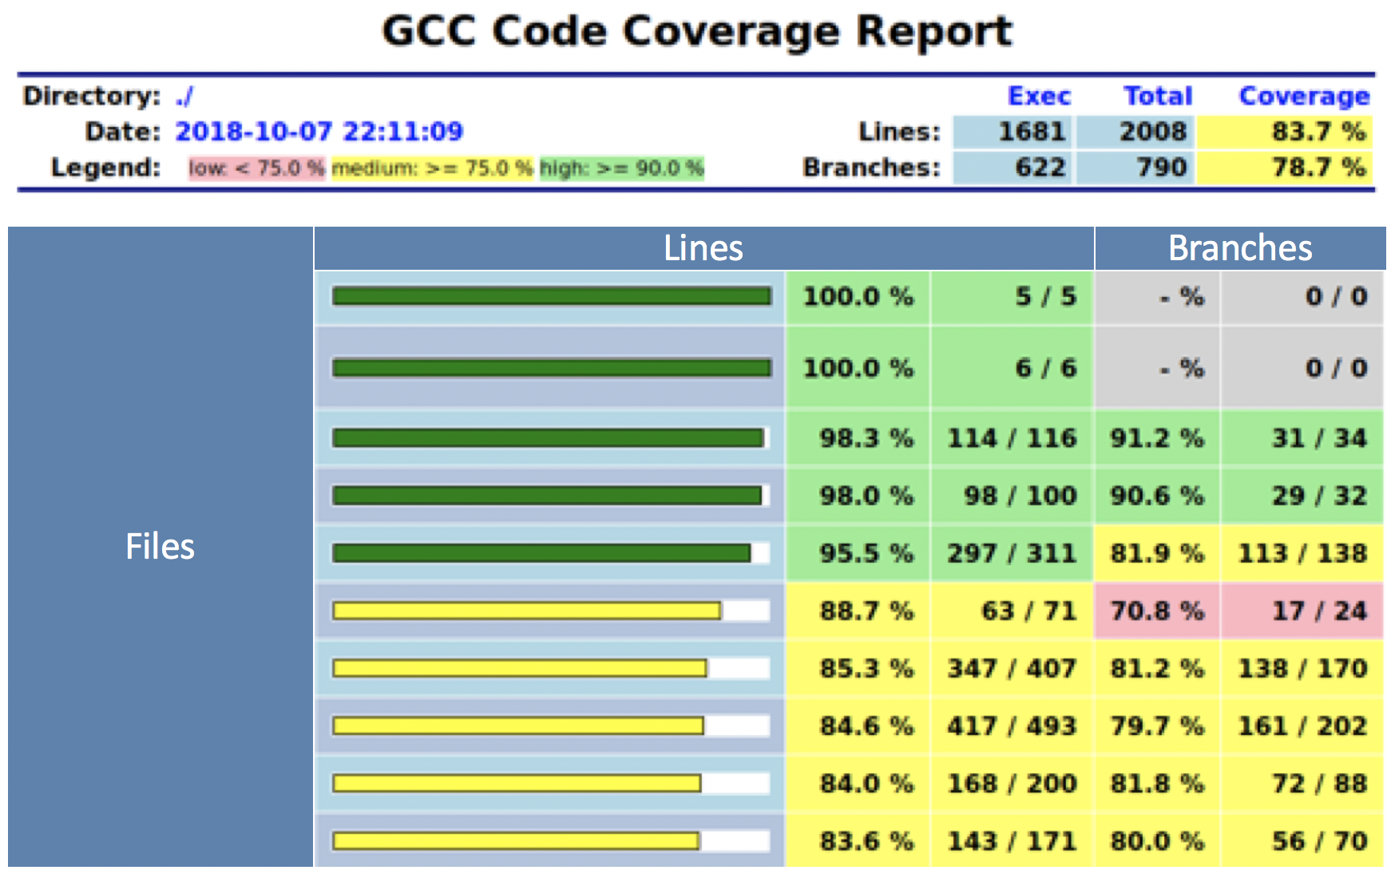
Automated Testing
Unit Test
Test Boundary: C Function
Unity
CMock
Code Coverage

Slide 15
Automated Testing
Application Test
Test Boundary: cFE Application
COSMOS Ruby Scripts

Slide 16
Automated Testing
System Test
Test Boundary: FSW
Operational Scenarios
Test as You Fly
Heritage Ground System Scripts

Slide 17
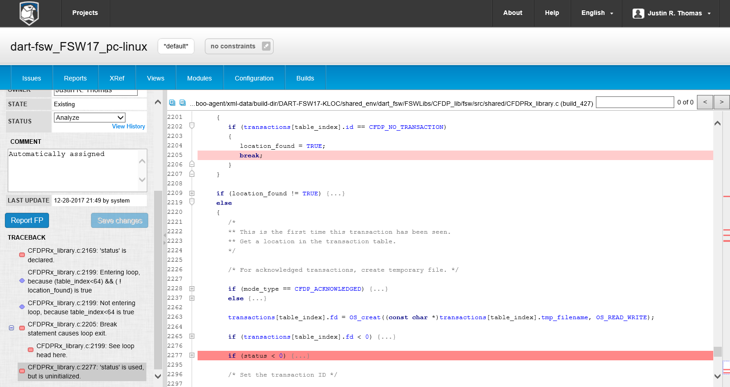
Automated Testing
Automated Reviews and Assurance
Static Analysis
  Klocwork
  CodeSonar
Dynamic Analysis
  Valgrind (SGCheck)
Continuous Integration

Slide 18
Development Workflow
Configuration Management
Continuous Integration (CI)
Continuous Delivery (CD)
Hardware Verification

Slide 19
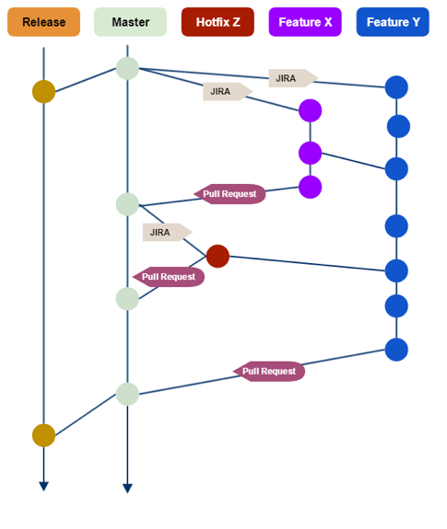
Development Workflow
Configuration Management
Tools
  Git
  Atlassian BitBucket
  Atlassian Jira
Branching
Pull Requests

Slide 20
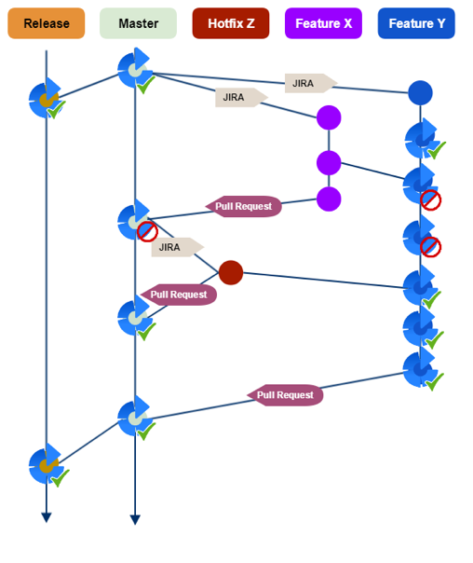
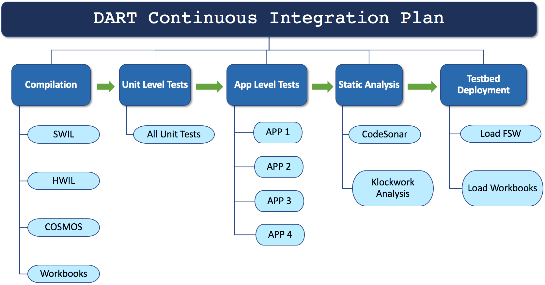
Development Workflow
Continuous Integration (CI)
Atlassian Bamboo
Branch Plans

Slide 21
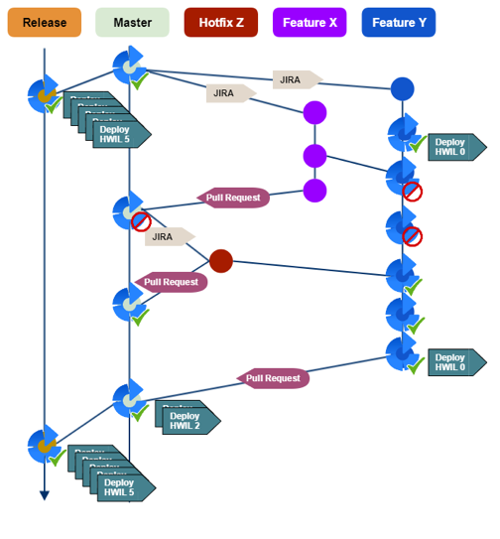
Development Workflow
Continuous Delivery (CD)
Atlassian Bamboo
Release CM
Testbed CM

Slide 22
Development Workflow
Hardware Verification
Final “For Score” Tests
Combination of:
  Manual/Exploratory Testing
  Scripted Test with Automated Analysis
  Scripted Test with Manual Analysis
  Stress Testing

Slide 23
Case Study: NEXT-C Thruster
NEXT-C = Evolutionary Xenon Thruster-Commercial
Challenges
  Early Initial Integration Test (Spacecraft Avionics not available)
  Parallel Development (Maturing ICD)

Slide 24
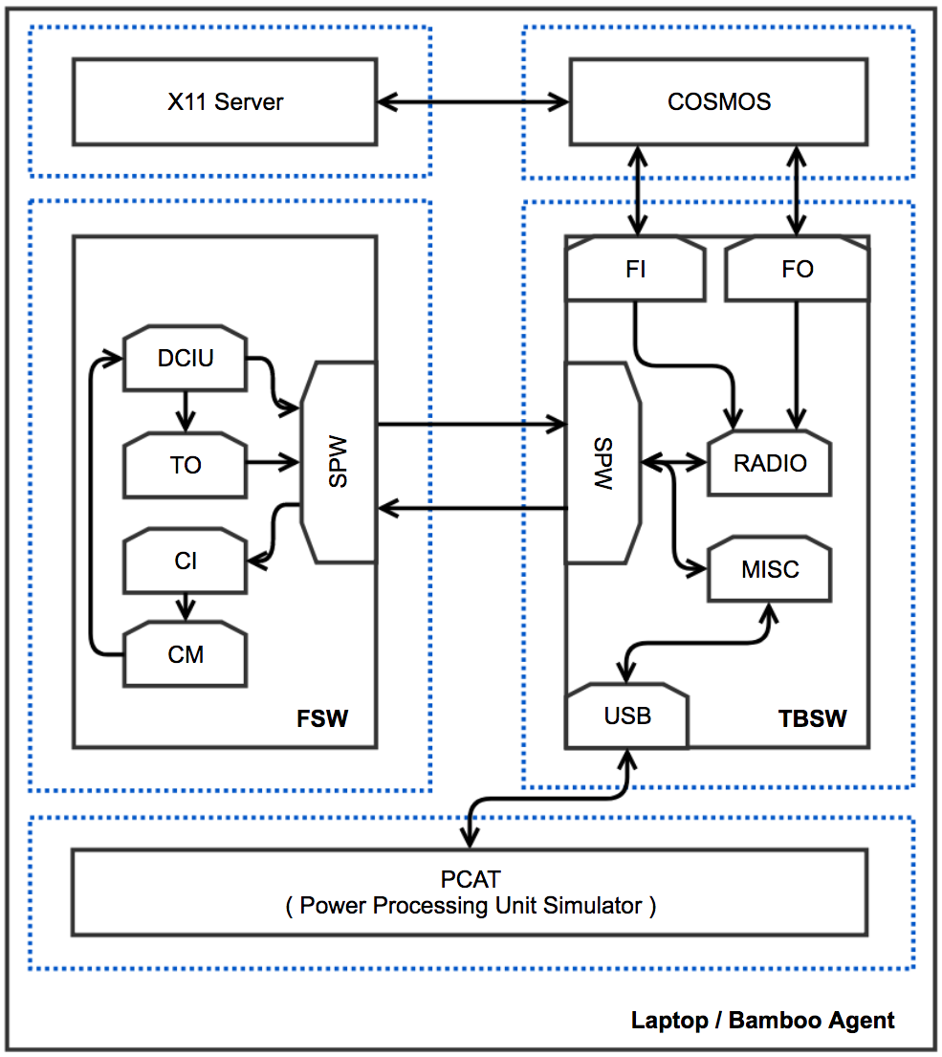
Case Study: NEXT-C Thruster
Test Progression – Step 2
SWIL Environment
Basic NEXT-C Software Emulation

Slide 25
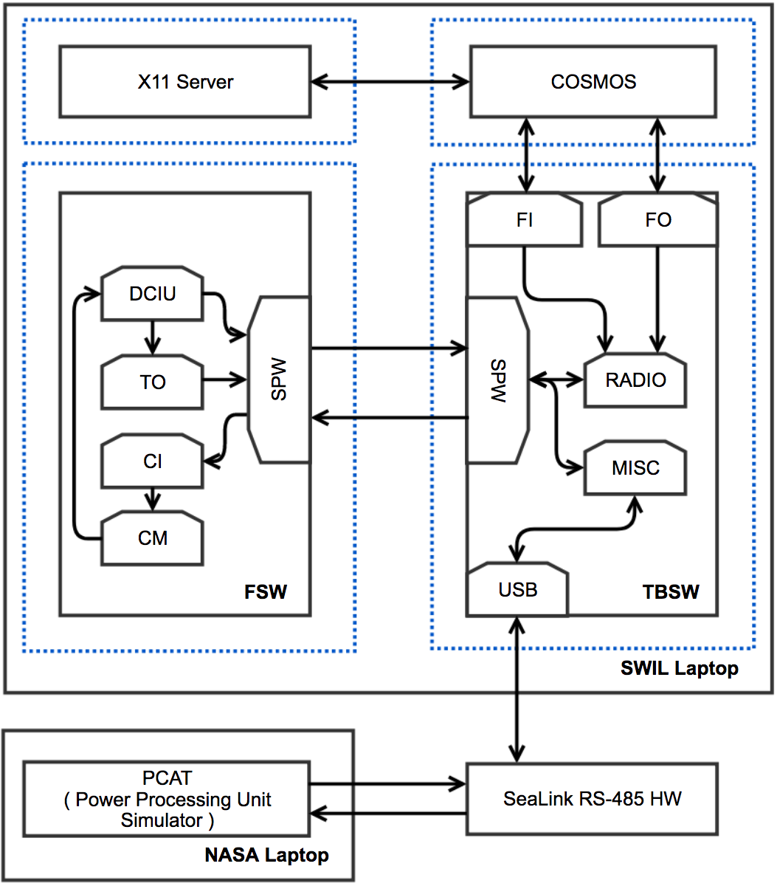
Case Study: NEXT-C Thruster
Test Progression – Step 3
SWIL Environment + Serial Gateway
NEXT-C HWIL Emulation

Slide 26
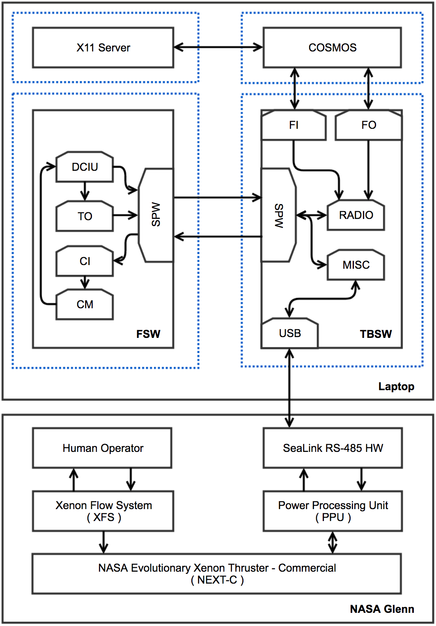
Case Study: NEXT-C Thruster
Test Progression – Step 5
SWIL Environment + Serial Gateway
NEXT-C Hardware

Slide 27
Case Study: NEXT-C Thruster
DevOps Benefits
Integration test event with actual FSW and minimal hardware:
  Laptop
  USB Serial Interface dongle
Tight Development Feedback Loop
Automated Test Regiment
Progressive Test Environments
Successful test!

Slide 28
Acknowledgements
NASA Planetary Defense Coordination Office (PDCO)
JHU/APL
DART Team
And thank you to SwRI and the Flight Software Workshop Organizing Committee

