Slide 1
G&C, Glue, and 42 Independent Dynamics for Independent Testing – Results: One Year Later
Mark Suder
Systems Engineer
TMC Technologies
NASA’s IV&V Program
Image Credit: NASA/JHU APL

Slide 2
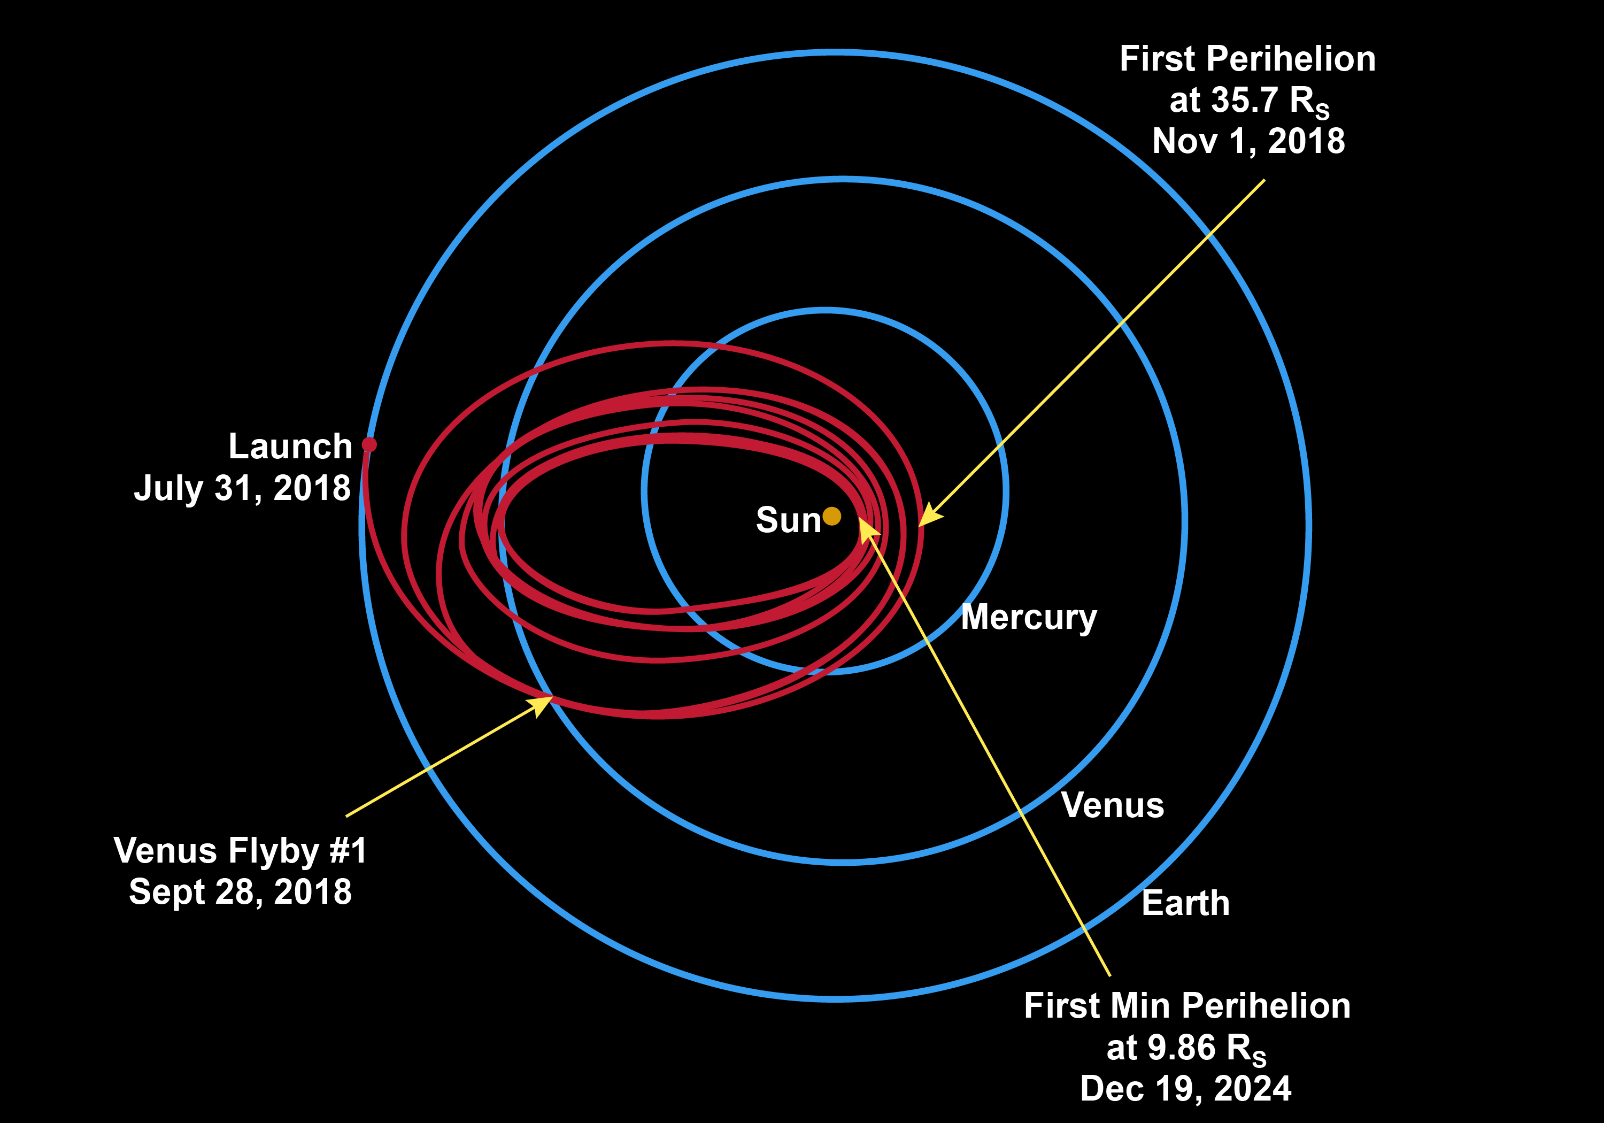
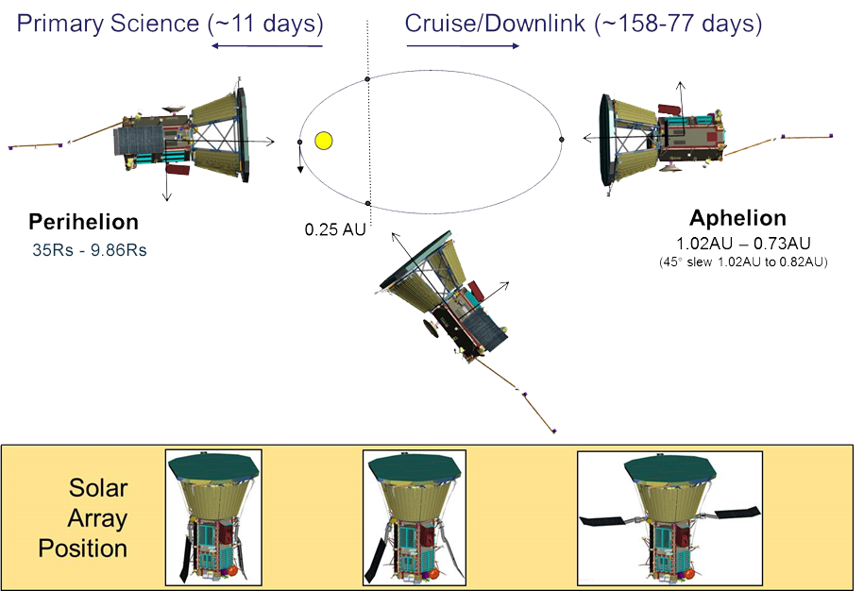
Parker Solar Probe (PSP)
Swoop closer to the Sun’s surface than any spacecraft before it
Face brutal heat and radiation conditions
Protected by a 4.5-inch-thick carbon-composite shield
Withstand temperatures that reach nearly 2,500 degrees Fahrenheit
G&C pointing is incredibly important!

Slide 3
BLUF – Why?
NASA’s Independent Verification and Validation Program
Key: Independence
Managerially, financially, technically
Software within the system focus
A NASA IV&V Engineer saw an opportunity:
Single truth/FSW G&C Matlab/Simulink model developed by the PSP project
Can IV&V have an independent truth source?

Slide 4
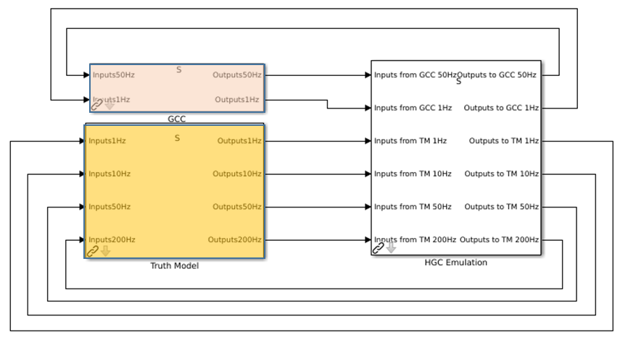
PSP G&C Testbed Goals
PSP dynamics are defined as a Simulink project.
S/C behavior and physics in the “truth model” → Matlab/Simulink simulation, unused in flight
S/C FSW as the “hand generated code” → Matlab/Simulink in the simulator, hand generated C for flight
S/C Guidance and Control as the “GCC model” → Matlab/Simulink, autocoded into C for flight
PSP G&C Testbed Goals
Interface with PSP G&C flight software C source
S/C behavior and physics modeled using 42 General-Purpose, Multi-body, Multi-spacecraft Simulation software
Test hand generated and Matlab/Simulink autogenerated source code which comprises the PSP G&C flight software

Slide 5
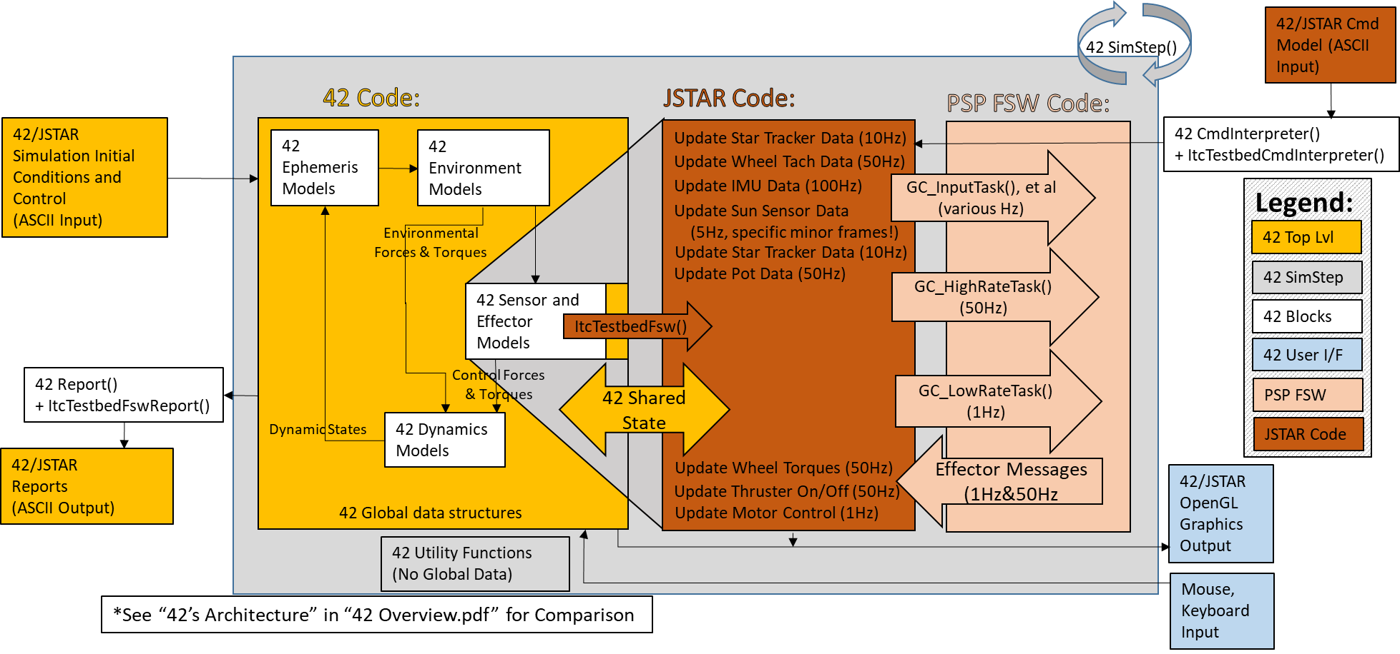
PSP G&C Testbed Architecture
Notes:
Portions borrowed from “42’s Architecture”
Talking points: After going over the architecture, describe where the bulk of the ITC/JSTAR work was:
Framework/architecture development
Development of the sensors/effectors one at a time, with the commands and reports for each sensor/effector being developed in parallel with sensor/effector development
Swapping out PSP FSW Code versions… became easy for ITC/JSTAR; but lots of regression testing for IV&V – but then automation/streamlining of regression tests was accomplished by IV&V

Slide 6
IV&V Uses
Add assurance to critical scenarios / address the IV&V three questions
Accomplish assurance goals
Independent test of high-level mission capabilities
Independently test coverage gaps identified in test case reviews
Independent test to provide evidence to close Technical Issue Memorandums
Ability to independently test how the software will behave under adverse conditions
Development of assertions not covered by requirements
Coverage of requirements and assertions evaluated in analysis of test cases
Reduce risk through targeted testing of perceived risk areas
A test analysis oracle to mockup project GN&C tests
Quick turnaround testing outside the Simulink environment
Learning how the sensors/actuators really work and interact
Assessing G&C performance improvements in subsequent flight software builds
Lower the residual risk to mission safety

Slide 7
Video
Visualization can allow the analyst to “see” what the code is causing to happen. Resulting output files can be analyzed to understand behavior.
Notes:
0:00 = 4373.0 = START Video, Primary – Sun @ 55 degrees toward –X, Secondary - Velocity toward +X
0:16 = 4535.0 = Momentum Dump Start
0:19 = 4562.0 = Momentum Dump End
0:23 = 4600.0 = Primary – Sun @ 45 degrees toward –X, Secondary – Velocity toward +X
0:36 = 4734.0 = Finish Slew
1:03 = 5000.0 = Primary – Sun @ 45 degrees toward –X, Secondary – Earth toward –X
1:13 = 5105.0 = Finish Slew
1:15 = 5119.0 = END Video

Slide 8
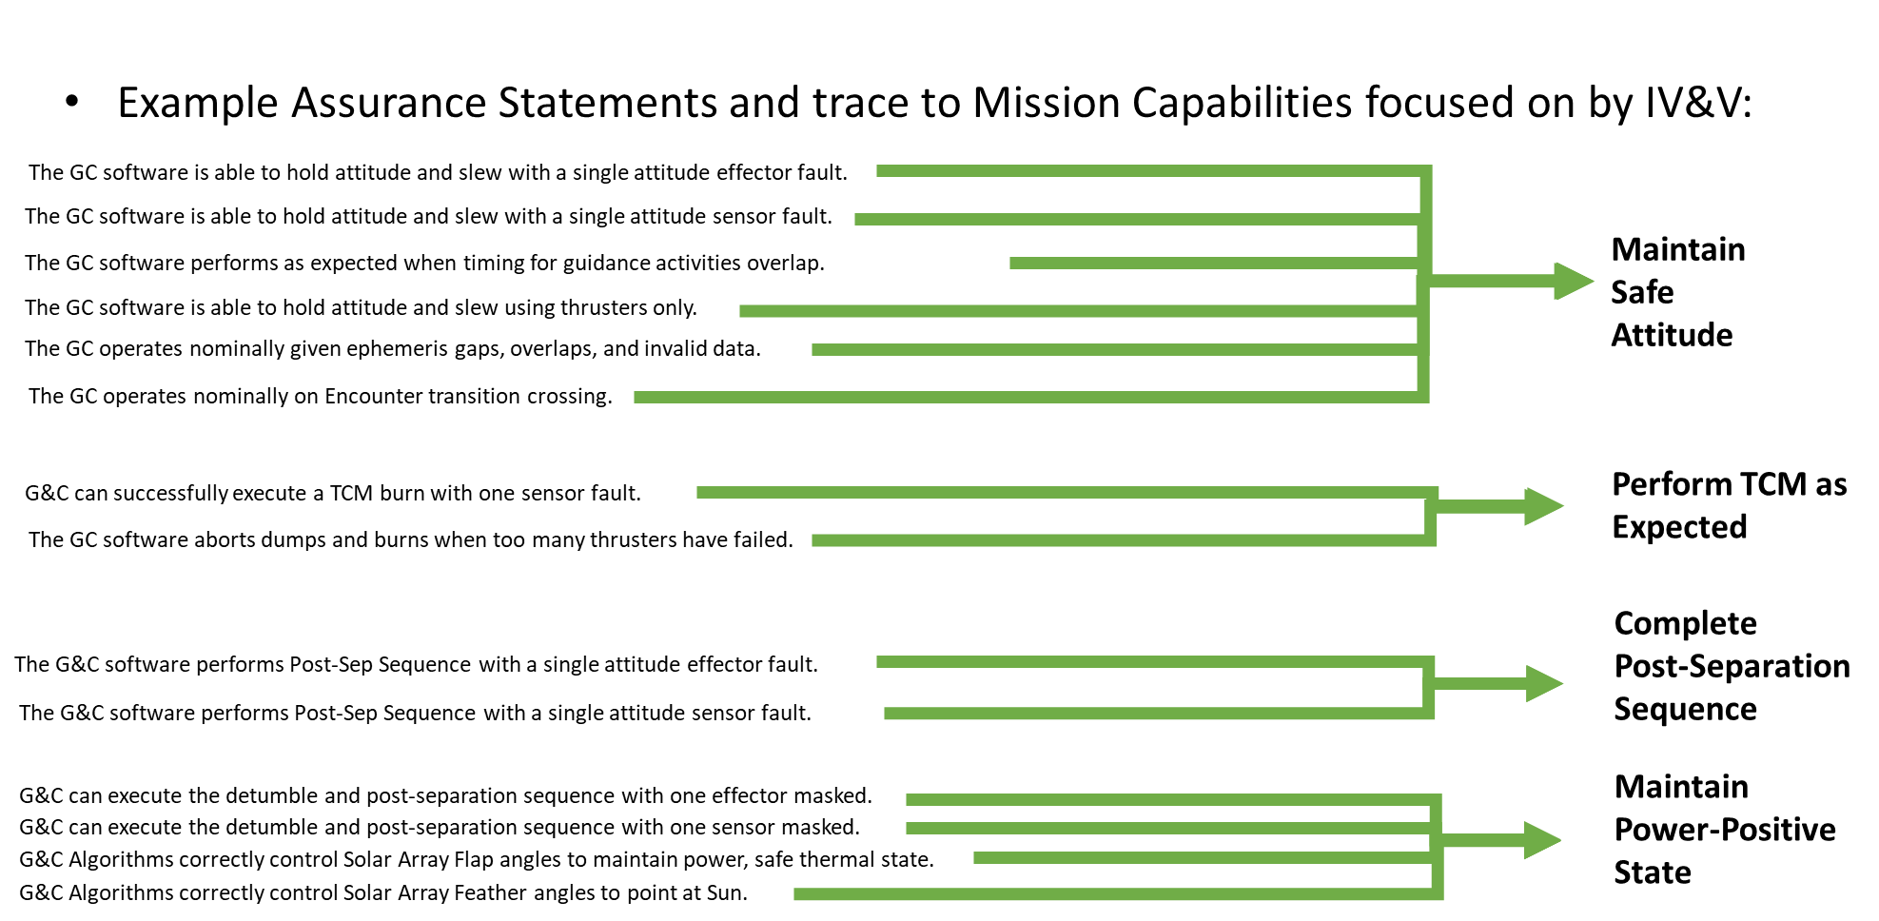
Assurance -> Mission Capabilities

Slide 9
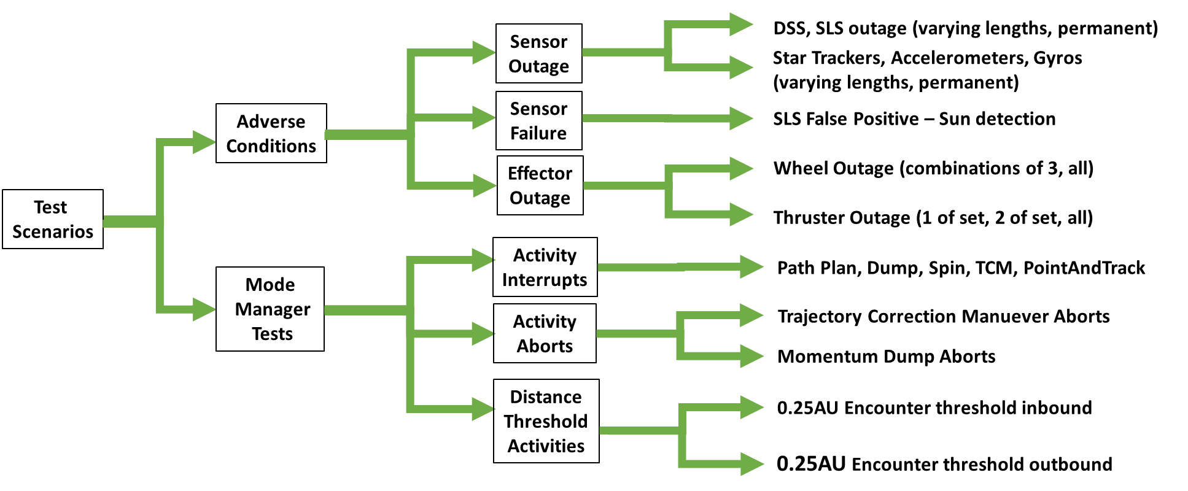
Baseline Tests to > 100 Sub-Scenarios

Slide 10
Independent Test Overview
Aphelion | Perihelion | Inbound .25AU
Baseline | Baseline | Baseline at .25AU inbound
Wheel 0 Mask | Wheel 0 Mask | in a Path Plan when a path plan interrupts
Wheel 1 Mask | Wheel 1 mask | in a burn when a path plan interrupts
Wheel 2 Mask | Wheel 2 mask | in a burn when a path plan interrupts version 2
Wheel 3 Mask | Wheel 3 Mask | in a spin when a path plan interrupts
Thruster Control only (no wheels) | Thruster Control Only | in a dump when a path plan interrupts
ST Outage | Commanded Momentum Dump | in a Path Plan when a spin interrupts
Gyro Outage | Commanded Momentum Dump, Wheel 0 Mask | in a burn when a spin interrupts
Rerun with 3 accelerometers | Commanded Momentum Dump, Thruster 1 Mask | in a dump when a spin interrupts
rerun with 4 accelerometers - turn off two during burn | Intermittent ST Outages | in a Path Plan when a dump interrupts
Intermittent gyro outages | Intermittent gyro Outages | Outbound .25AU
Intermittent gyro outages 15 sec - during maneuver | Intermittent ST and Gyro Outages | Baseline at .25AU outbound
Intermittent gyro outages 20 sec - during maneuver | Momentary SLS 0 SP, Sat false-positive immediately before dump | in a Path Plan when a path plan interrupts
Intermittent gyro outages 30 sec - during maneuver | Intermittent SLS SP, Sat false-positive on SLS 0 | in a burn when a path plan interrupts
Intermittent gyro outages 40 sec - during maneuver | Intermittent SLS false-positive on SLS 0, 7 | in a spin when a path plan interrupts
Intermittent gyro outages 60 sec - during maneuver | SP, Sat False-positive on SLS 0 | in a dump when a path plan interrupts
Intermittent ST outages | SP, Sat False-positive on SLS 0,7 | in a Path Plan when a spin interrupts
Intermittent ST outages 15 sec - during maneuver | SP, Sat False-positive on SLS 0;4 | in a burn when a spin interrupts
Intermittent ST outages 20 sec - during maneuver | SP, Sat False-positive on SLS 0,7; 4,11 | in a dump when a spin interrupts
Intermittent ST outages 30 sec - during maneuver | SP, Sat False-positive on SLS 0;2 | in a Path Plan when a dump interrupts
Intermittent ST outages 40 sec - during maneuver | SP, Sat False-positive on SLS 0,7; 2,9 | Post-Separation
Intermittent ST outages 60 sec - during maneuver | SLS Outage | Baseline scenario
Intermittent ST & gyro outages | MET Invalid | DSS Outage
rerun with 1 thrusters mask | Ephemeris offset with gap | IMU Outage
rerun with 2 thrusters mask | Ephemeris offset with overlap | ST Outage
rerun with 1 thruster mask (Overcurrent) | Overlap in Ephemeris Spans | ST/IMU Outage
rerun with 2 thrusters mask (overcurrent) | Gap between ephemeris spans (during test) | No ephemeris
rerun with 1 DSS |  | Wheels masked (all)
DSS12 offset 2 deg (at 7310/7410s) |  | Thrusters Masked (all)
SLS (0,7)false positive during TCM |  | Project Regression Test
in a Path Plan when a path plan interrupts |  | Baseline Scenario
in a burn when a path plan interrupts
in a burn when a path plan interrupts, second path plan interrupts
in a spin when a path plan interrupts
in a dump when a path plan interrupts
in a Path Plan when a spin interrupts
in a burn when a spin interrupts
in a dump when a spin interrupts
in a Path Plan when a dump interrupts

Slide 11
Summary
Baseline test comparison showed high-fidelity of ITC Testbed.
Testbed setup and command language enabled quick test generation.
Independent Test cases trace up to high-level mission capabilities.
In the case of the residual risk, Independent Test can potentially lower the residual risk to mission safety.

Slide 12
Bottom Line
Bottom line – why this is important
Provided independent testing capability based on IV&V identified need
Glue
PSP
G&C
42 –
Independent
Dynamics
Glue

Slide 13
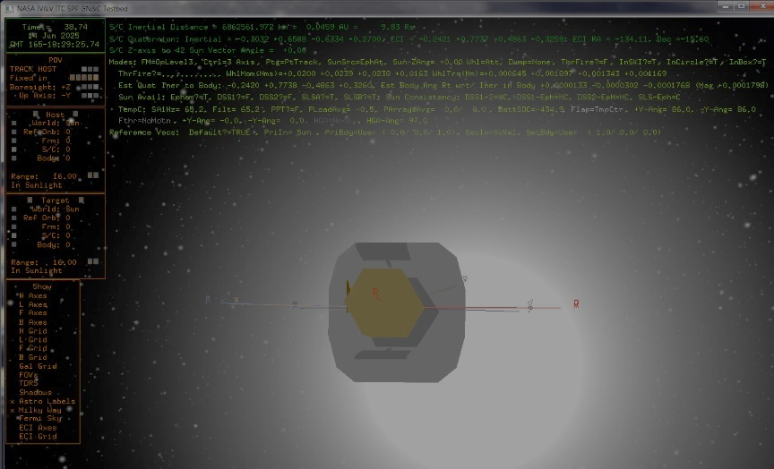
Q&A

Slide 14
Backup

Slide 15
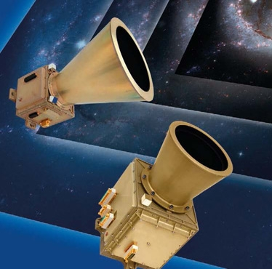
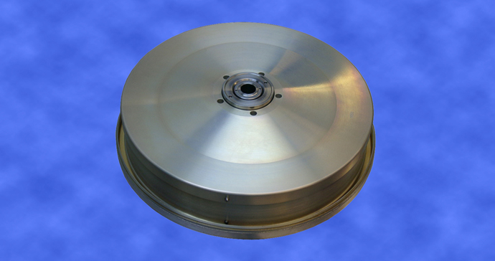
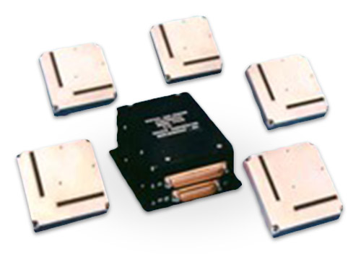
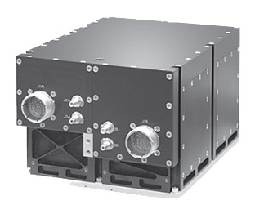
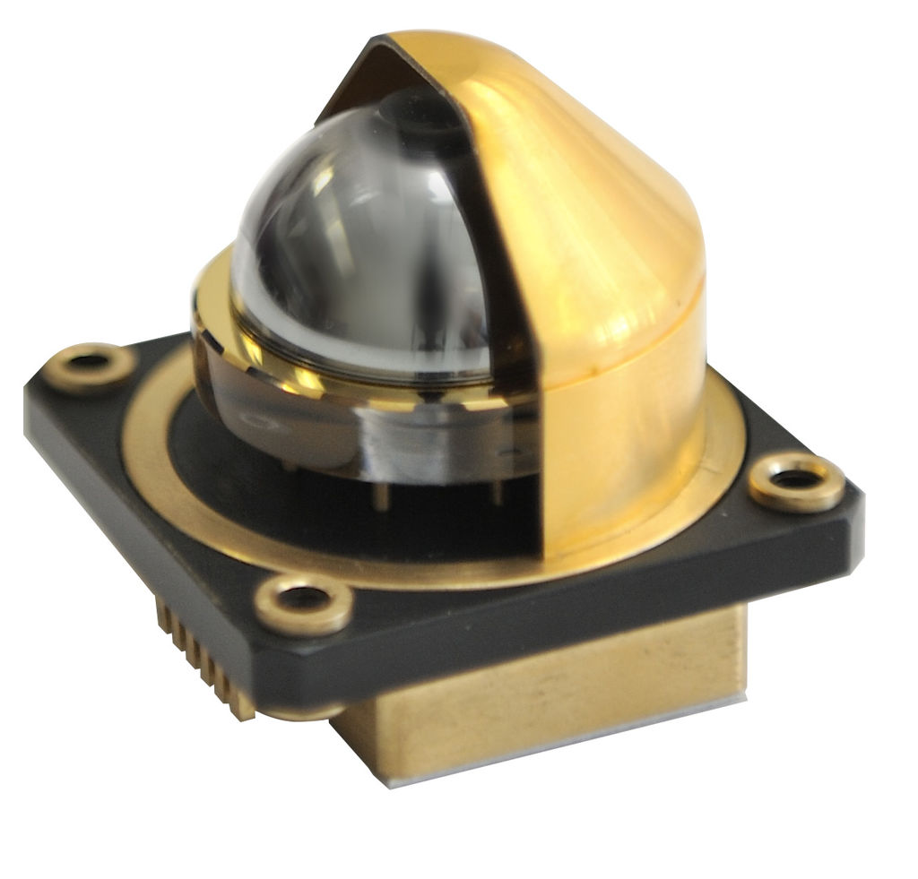
Sensors/Actuators
Star Trackers
Reaction Wheel Motors/Tachometers
Solar Limb Sensors
Digital Sun Sensors
IMU/Gyroscopes/Accelerometers
Thrusters
Solar Array Motors/Potentiometers
High Gain Antenna Motor/Potentiometers

