Slide 1
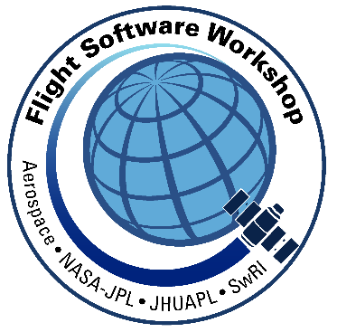
Using a Test-Driven Development Approach for Space Mission Flight Software
Robert Klar
robert.klar@swri.org
Greg Dunn
gregory.dunn@swri.org
This is a non-ITAR presentation, for public release
and reproduction from FSW website.
1

Slide 2
What is Test-Driven Development (TDD)?
Test-Driven Development is a process that relies on a very short development cycle to build software incrementally.
  The term is associated with software engineer Kent Beck who published the book Test-Driven Development by Example in 2002.
  Beck himself considers his book a rediscovery of the technique, crediting it to an ancient programming book which described programming with input tape.
Test-Driven Development Cycle (Microcycle)
  Add a test
  Run tests to see if new test fails
  Write the code
  Run tests to pass
  Refactor code

Slide 3
Why Use Test-Driven Development (TDD)?
Top 3 Reasons:
  Reduce debug time
    The TDD cycle encourages the incremental build up. Code is added in small parts and tested continuously. This makes it more likely to catch a mistake early.
  Provide good documentation of tests
    The test framework can provide good documentation of how components work.
  Automate regression testing
    TDD relies on unit-test frameworks and automation. This helps to create a comprehensive regression test suite.

Slide 4
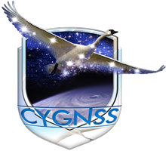
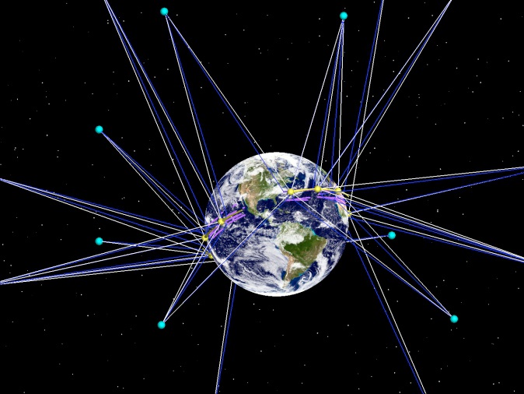
CYGNSS Mission
Cyclone Global Navigation Satellite System (CYGNSS)
  Constellation of 8 low-earth orbiting microsatellites that receive both direct and reflected signals from the Global Positioning System (GPS) satellites
  Direct signals pinpoint satellite positions, while the reflected signals respond to the ocean surface roughness, which can be used to derive wind speed
http://clasp-research.engin.umich.edu/missions/cygnss
Objective:
Study the relationship between ocean surface properties, moist atmospheric thermodynamics, radiation, and convective dynamics, to determine how a tropical cyclone forms and strengthens.
4

Slide 5
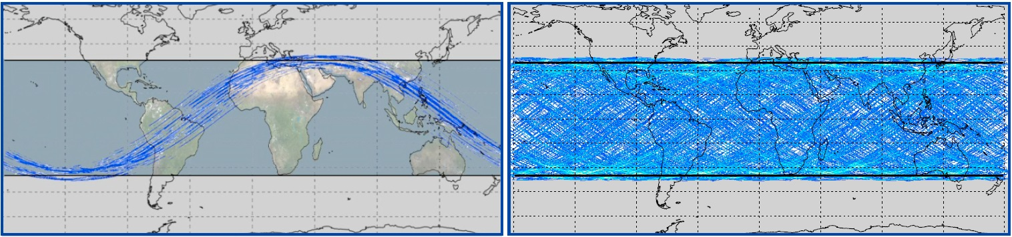
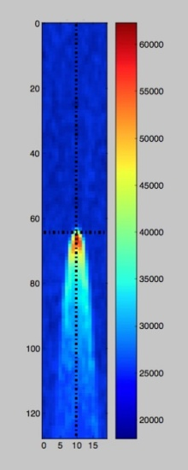
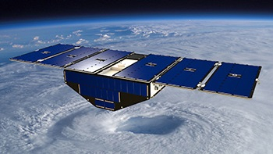
CYGNSS Mission
http://clasp-research.engin.umich.edu/missions/cygnss
The 8 CYGNSS microsatellites are at an inclination of 35 degrees and are each capable of measuring 4 simultaneous reflections, resulting in 32 wind measurements per second across the globe. Ground tracks for 90 minutes (left) and a full day (right) of wind samples are shown above.
First Light
5

Slide 6
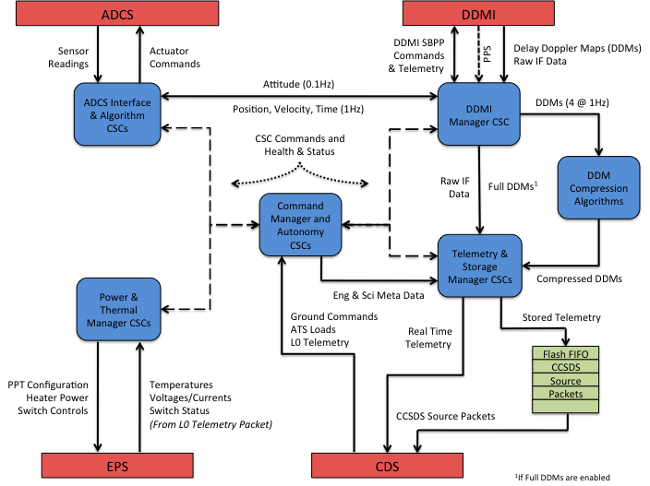
CYGNSS Flight Software
6

Slide 7
CYGNSS Unit Testing (Legacy)
Examined unit tests and compared to Unity and CppUTest
  Similar features to those provided by Unity and CppUTest
  Test groups are consolidated into a C function
  Test structured to use the CHECK() macro
    Analogous to TEST_ASSERT() in Unity except that it provides more information on the particular condition that is being checked.
    If not TRUE, it will cause the Test Group to be aborted.

Slide 8
CYGNSS Unit Testing (Legacy)
…

Slide 9
Test-Driven Development Tools
Ceedling
  A build system which is available as a Ruby gem. It integrates nicely with CMock and Unity.
Unity
  Simple unit test framework based on C. It provides a consistent way to organize tests into groups.
CMock
  A tool that generates C code from C header files. This is useful when creating test stubs or simulations of functions.
“ThrowTheSwitch.org: C Code That Doesn’t Suck”
http://www.throwtheswitch.org

Slide 10
Legacy Test Framework vs. TDD Tools
Advantages
  Already exists in CYGNSS development tree
  Includes basic primitives that are used throughout unit test cases
Disadvantages
  Not a standard framework
  Does not provide as much detailed reporting information as Unity
    Number of Checks
    Number of Ignored
    Number of Filtered Out
  Does not provide integration with other useful tools such as Ceedling and CMock

Slide 11
CYGNSS Unit Testing (Plan Forward)
Seven (7) change requests are planned to be included in the flight software. Since these changes are few in number, we plan to make use of TDD tools (Ceedling, Unity, and CMock) for new unit test cases and adapt existing test cases that need to change.
  Redefine CHECK() to simply use TEST_ASSERT()
  Rename test routines to make use of test runner capabilities
  Move test stubs into a support files (Mocks and Spies)
#define CHECK(cond) \ TEST_ASSERT(cond, STR(cond))

Slide 12
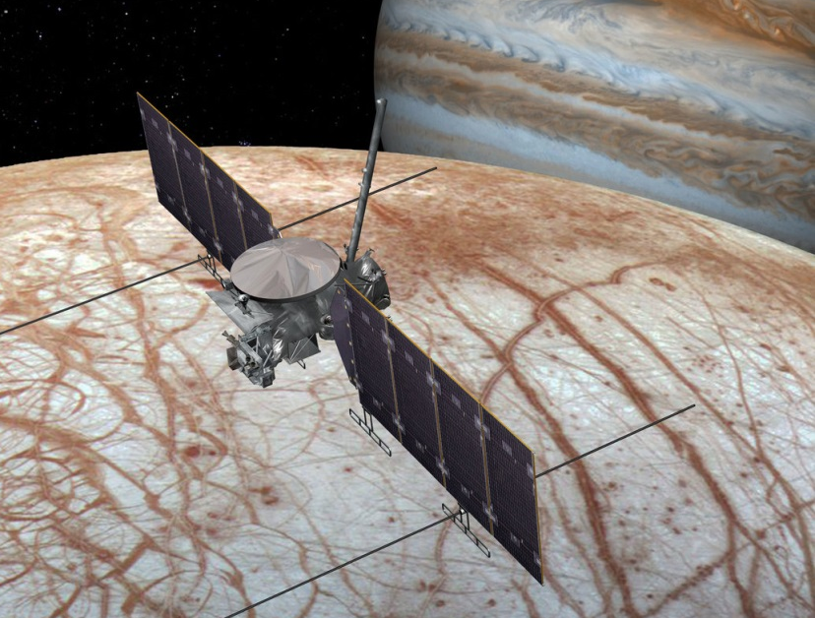
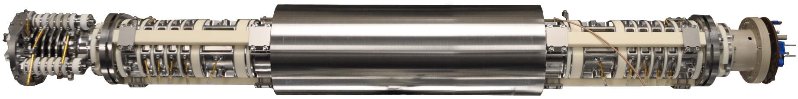
Mass Spectrometer for Planetary Exploration (MASPEX)
Europa Clipper will reconnoiter Jupiter's moon Europa to see whether it could harbor conditions suitable for life
MASPEX is a very high resolution Mass Spectrometer that will determine the composition of the surface and subsurface ocean by measuring Europa's extremely tenuous atmosphere and any surface material ejected into space
12

Slide 13
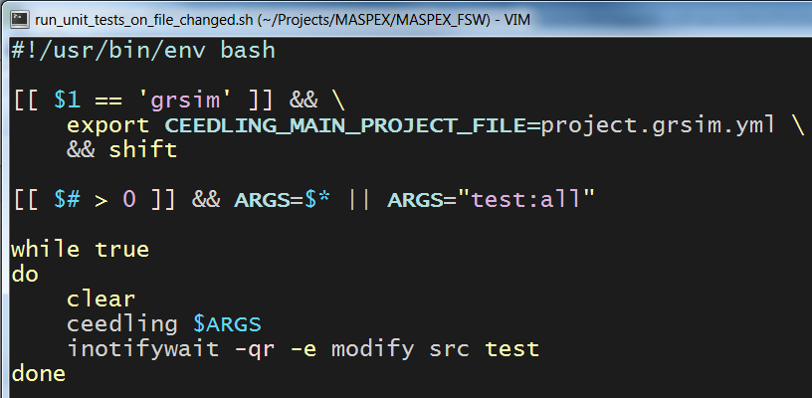
MASPEX Unit Testing
Use Ceedling, Unity, Cmock (from throwtheswitch.org)
Simple bash script to automatically run unit tests when file changes are detected
Tests can be executed in a native Linux environment or against the GRSIM LEON3 simulator
  Native tests currently run in about 4 seconds; GRSIM tests run in about 30 seconds
TDD from the start

Slide 14
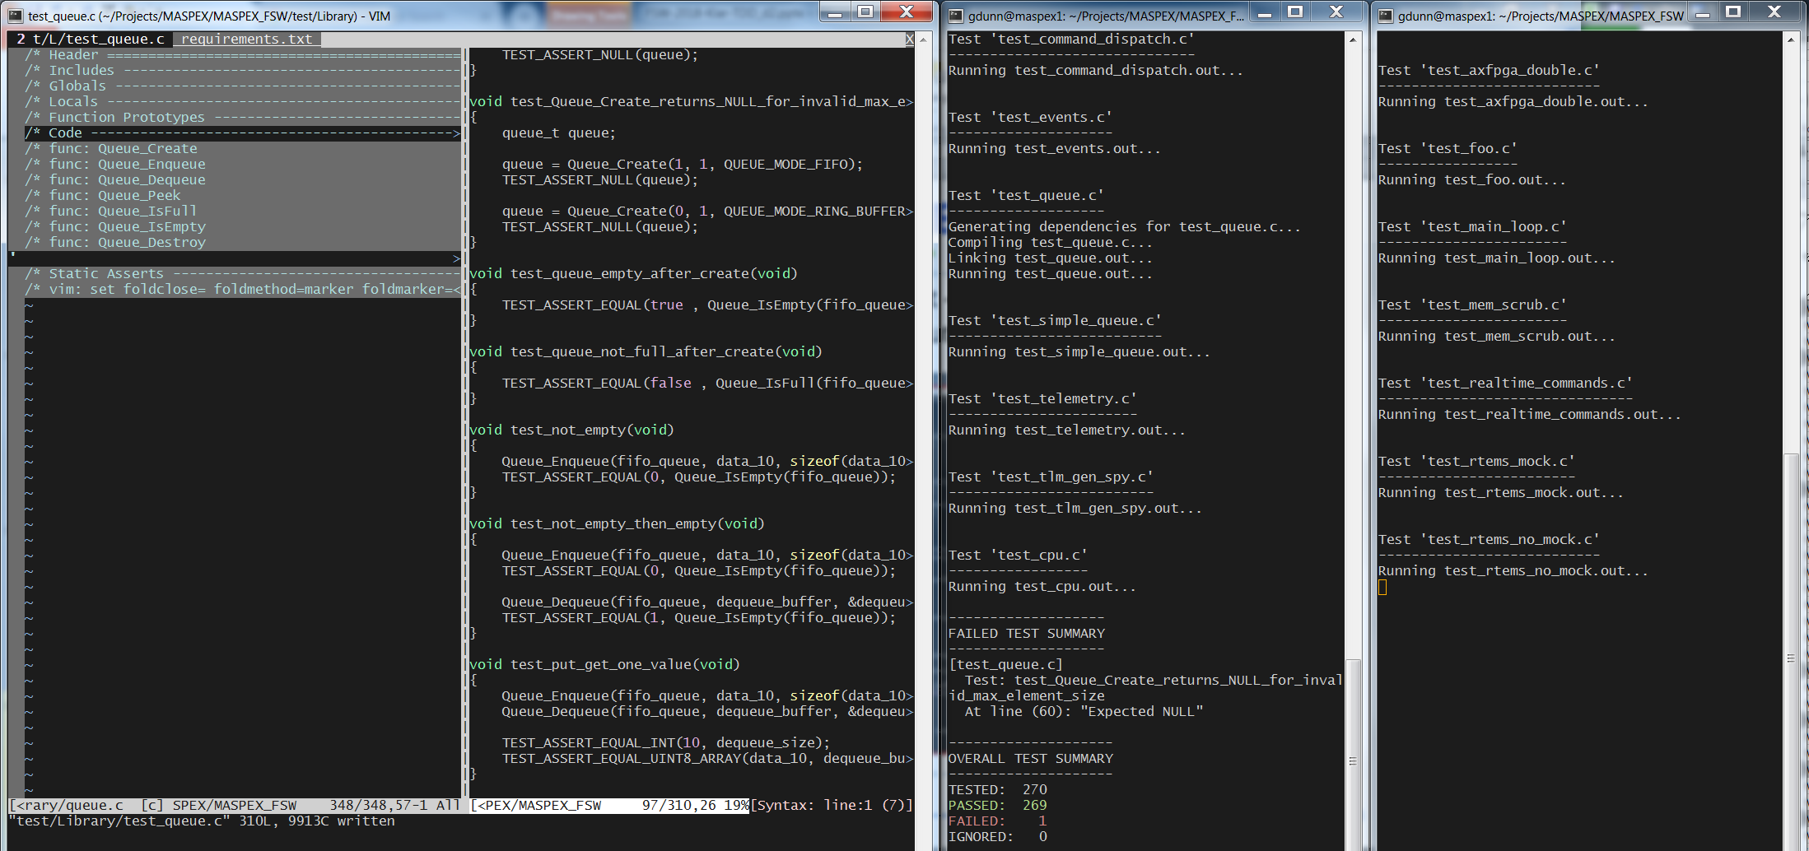
MASPEX Unit Testing cont.
Typically use a 4-window layout – Application source, Unit Test source, Linux output, GRSIM output
Application Source
Unit Test Source
Linux Output
GRSIM Output

Slide 15
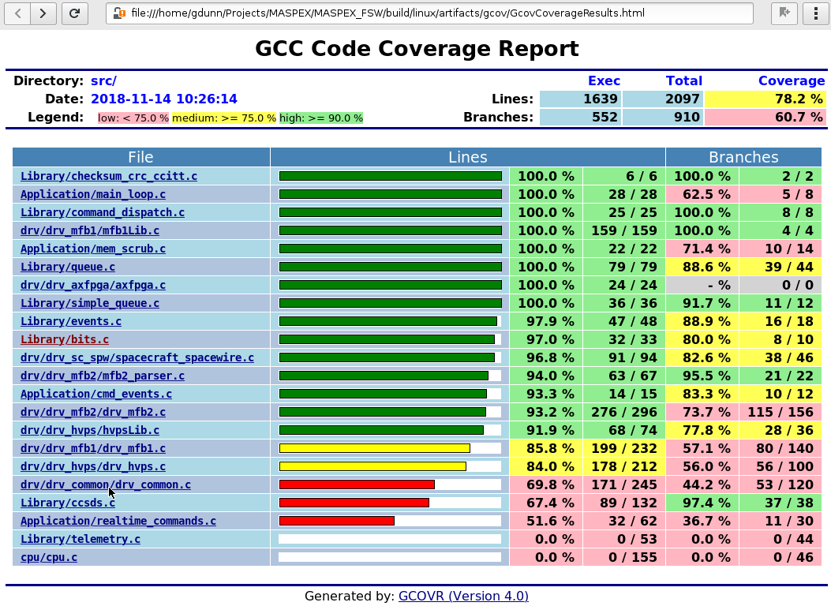
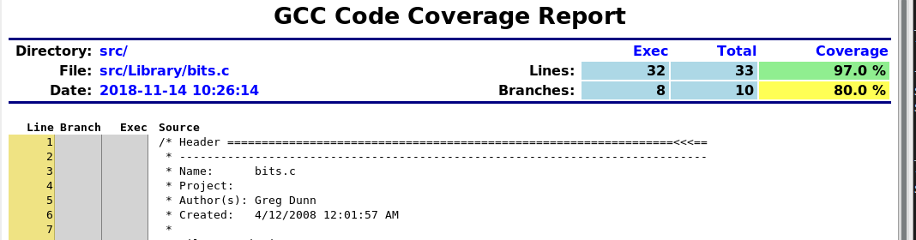
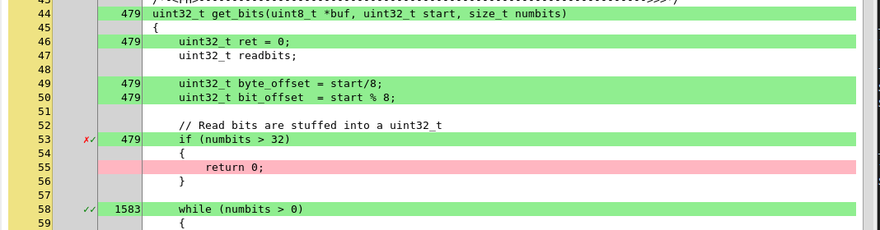
Integrated Coverage Reports
Ceedling integrates nicely with Gcov and can automatically generate code coverage reports.

Slide 16
Test-Driven Development Takeaways
Encourages cross-platform, modular code
Exposes bugs early
Provides early warning if a change breaks something
Automating test execution is a must
Have not quite gone ‘all-in’ for MASPEX development (full TDD micro-cycle)
Requires much discipline to keep with it
  It is easy to get ahead of the TDD Microcycle
Good References:
  K. Beck, Test-Driven Development: By Example, Addison Wesley, Reading, MA, 2002.
  J. Grenning, Test-Driven Development for Embedded C, Pragmatic Programmers, 2011.

Slide 17
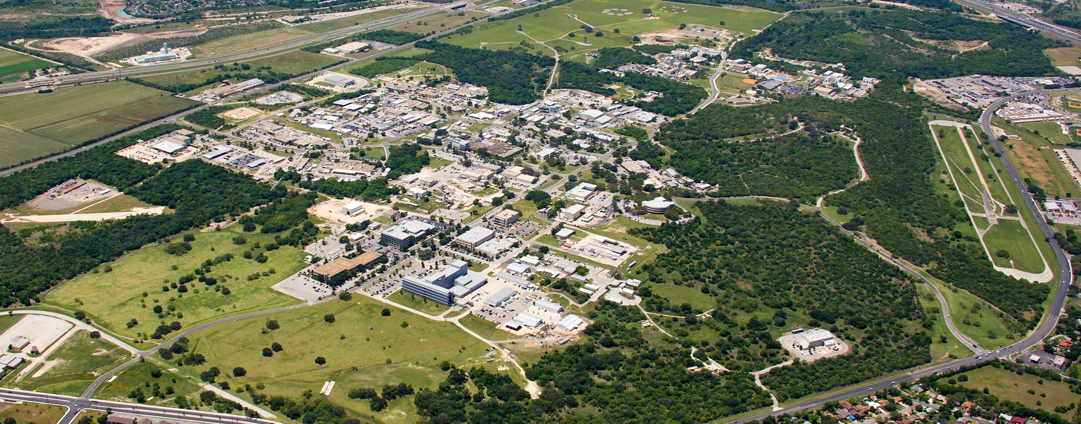
Questions?
Southwest Research Institute
Benefiting government, industry and the public through innovative science and technology

