Slide 1
Effective Integration and Testing of Geographically Distributed Space Systems Using Native Protocols Over IP
Tom Jackson, Greg Menke, James Dailey, Carlos Ugarte, Lester Jackson, Sara Haugh, Jerry Cote
  Goddard Space Flight Center
  Greenbelt, MD 20771

Slide 2
Presentation Agenda
Introduction
What is DSILCAS?
DSILCAS Benefits
System Description
The System in Action
  Constellation Lab Integration Tests
  Radio AOS IP Encapsulation Interoperability Tests
Lessons Learned
Next Steps
Questions

Slide 3
Introduction to DSILCAS
What is the DSILCAS project?

Slide 4
Introduction
Abstract
  Historically, the early -stage integration and validation of space system elements has occurred using co-located emulators, simulators and other virtual components, leaving true systems integration testing until much later in the development schedule (usually when the actual elements are integrated together during system I&T). While this approach has been used successfully for generations of satellite and launch systems, it has a number of significant problems, risks and not insignificant costs.
  This presentation describes the Distributed System Integration Lab Communications Adapter Set (DSILCAS) and some of the early results obtained in using it to provide cost-effective early-stage systems integration between actual engineering prototypes instead of simulated versions. As part of the NASA’s Constellation program, DSILCAS utilizes standard IP networking, tying together geographically distributed components which natively use non-IP communication busses, protocols and interfaces (e.g. LVDS, 1553, CCSDS AOS); making each component appear to the others as if they were directly linked via wired connection. Hence, inter-component functional testing can be performed even though the test units themselves may be in separate buildings on the same campus or on different continents.
  Our early results appear to demonstrate that within a few constraints, such an approach is technically practical, logistically simple, and benefits from an overall lower cost and level of effort, while uncovering integration problems that would have persisted until much later in the development cycle.

Slide 5
Introduction
DSILCAS
  Distributed System Integration Lab Communications Adapter Set
  Goddard Space Flight Center (GSFC)
  Civil Servants & Contractors
  Sponsored by NASA’s Constellation Program

Slide 6
Introduction
The DSILCAS Team
Program Management | Tom Jackson (thomas.m.jackson@nasa.gov)
Systems Engineering | Sara Haugh
Software Development | Carlos Ugarte Greg Menke Eric Lidwa Larry Alexander
Testing | Lester Jackson James Dailey
Hardware Engineering | Jerry Cote
Support | Jay Wilson Christina Kelly

Slide 7
Demonstrated Accomplishments
Transport of Ethernet, AOS & serial data between far-flung, geographically distributed systems
Use of existing WAN IP infrastructure
Validation of protocol and system implementations
Successful integration of systems

Slide 8
DSILCAS Benefits
Why do it?

Slide 9
DSILCAS Benefits
  Early Interface verification, system integration and validation
  Risk, cost and schedule reduction
  Turn-Key off-the-shelf solution
  Adaptation of multiple avionics interfaces
  Worldwide lab interconnectivity
  Network latencies measured and reported
    ~20 ms avg between centers
    Typically <= 1 ms added by system
GSFC
JPL
MSFC
JSC
KSC

Slide 10
System Description
What is the DSILCAS system?

Slide 11
System Purpose
Distributed System Integration Lab (DSIL)
Purpose
  To Connect Engineering Test Unit (ETU) boxes and flight-like interfaces to other ETU boxes and flight-like interfaces
  Supports the entire product life cycle

Slide 12
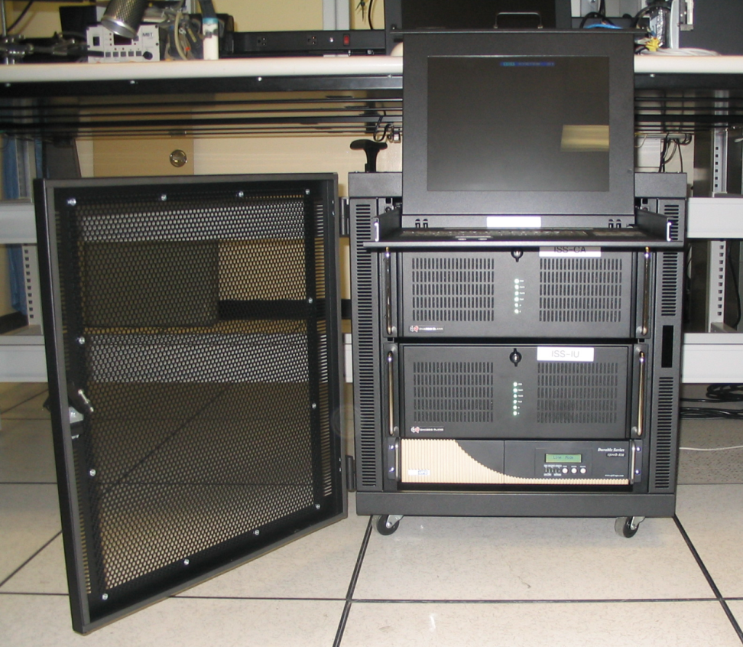
System Description
Mostly COTS Equipment
  Rackmounted Intel-based servers
  Ethernet, serial, Discrete & IRIG-B PCI cards
DSIL Interface Unit (DSILIU)
  Transfers data from flight interfaces across IP Networks
    Whatever goes in one side comes out the other side
    Data is delivered reliably and in order
DSIL Communication Adaptor (DSILCA)
  Moves data between interfaces (translator, media converter)

Slide 13
DSILCAS Supported Interfaces
Transmits Discrete Signals, Ethernet, RS-485, RS-422, and Radio Bitstreams across IP Networks
Commands, Telemetry, and IP packets can be transferred between interfaces
    IP packets are framed and sent out radio interfaces
    QoS Traffic management, CFDP File transfer, Data recording, etc
10/100/1000 Eth
10/100/1000 Eth
12x 28V Discrete Pairs In
12x 28V Discrete Pairs OUT
8x Rate Constrained GigE
4xRS-485
3xLVDS/RS-422
IRIG-B

Slide 14
DSIL Interface Unit
Operates independently of Internet Protocol (TCP/UDP/RTP/etc) and even transmits raw Ethernet frames
Simplest use of DSILIU is to connect two remote systems
How this benefits the user
  Use real flight interfaces early and often (raw Ethernet, radio framing, etc)
  No need to adapt your systems to less flight-like configurations for distributed development and testing
  Simulates co-located equipment with one platform, no need for multiple media converters

Slide 15
DSIL Communication Adaptor
  Acts as a translator or media convertor between IP and link layer protocols
  Data can be:
    Transmitted from a local or remote system to the DSILCA via TCP/UDP
    Converted to raw Ethernet
    Encapsulated/encoded into radio data streams
    Used to set or clear discrete signals

Slide 16
DSIL Communication Adaptor
  Simplest use of DSILCA is to translate between flight interfaces and Ethernet
How this benefits the user
  Use real flight interfaces early and often (raw Ethernet, radio framing, etc)
  Connect equipment with incompatible link layer interfaces

Slide 17
Features & Functionality
What does DSILCAS really do?

Slide 18
DSILCAS FEATURES
Use of standard commands & telemetry aids interoperability
Transport of link-layer protocols over IP permits the use of any payload
IPSEC or SSH port forwarding to encrypt and authenticate user datastreams
Copious system telemetry (~600 kbits/sec ) – greatly aiding identification and resolution of issues
Wide array of user interfaces: LVDS/485 bitstream, IP over AOS, raw Ethernet, digital I/O, 1553
Flight Software architecture means command and telemetry formats are well-specified and DSIL systems are fully remote controllable
Configuration is done via text files; local admin dictates interface configuration and selection- users may override in some cases

Slide 19
DSILCAS Functionality
User Sim
User Sim
Sim-to-Sim comms, as if by wire, using sim addresses & protocols
CA
CA
IP in, Raw Frame out
User interfaces (and local networks) entirely insulated from institutional LAN
IU
IU
Measure tunnel latency
Constellation std Commands & Telemetry
Controller

Slide 20
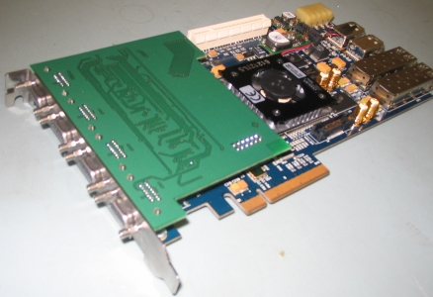
DSILCAS Radio - Hardware
8x PCIe COTS FPGA carrier board with
custom LVDS & RS-422 driver daughter card
Rev 1
  4 independent FDX serial ports
  No Randomization, LDPC & Framesync
  35 Mbps
Rev 2
  3 independent FDX serial ports w/ I&Q channels
  Randomization, LDPC & Framesync in firmware
  120 Mbps

Slide 21
DSILCAS Radio Card
Rev 1 of the DSILCAS Radio Card

Slide 22
DSILCAS Radio Driver
Radio card driver offers each port as a synchronous serial port (DSILIU) or as an IP interface (DSILCA)
Features
  IP over AOS Encapsulation w/ optional frame CRC
  Optional ½ rate LDPC encoding
  Optional CCSDS Randomization
  Framesync w/ 32 or 64 bit ASM
  NRZ-L/NRZ-M encoding, RX/TX bit inversion

Slide 23
AOS IP Encapsulation Interoperability Tests
DSILCAS in Action

Slide 24
The Problems
CCSDS acceptance of AOS IP Encapsulation standard requires at least two implementations to demonstrate inter-operation
  GSFC Constellation Systems Test Lab SDR
  JPL Protocol Test Lab SL2E
Both are firmware/software implementations
The common interface is LVDS Clock/Data
  How to connect them without requiring modifications that may compromise test coverage?
Both systems are too large & complicated to be shipped
Travel would be prohibitively expensive
Tests required about 3 weeks of actual test time
Preliminary integration, diagnostics, bug fixes on both ends required several additional weeks

Slide 25
The Solution: DSILCAS
A bidirectional, full-duplex bitstream connection over the NASA WAN, interfacing the two radio systems
Monitoring functions capable of AOS Framesync and protocol validation - important!
Institutional firewall “workarounds” until official network configuration changes took effect (which naturally occurred after testing was completed)

Slide 26
Test Setup
128kbps LVDS Clock/Data, TX and RX
Radio Transport linking SL2E-SDR
Copy of Radio Transport bitstream
GSFC CSTL SDR
JPL PTL SL2E
CSTL-IU
SCAN-IU
Software Monitoring of AOS frame , Synchmark, CRC, ie “wire truth data”
NASA WAN
VAL1-IU
(ssh port forwarding between SCAN-IU and CSTL-IU because institutional firewalls did not permit end-to-end connectivity)
JPL Institutional Firewall
GSFC Institutional Firewall

Slide 27
Test Results
Success!
The two radio implementations exchanged IP and MPoFR (IP Header Encap data units) correctly with variety of link utilizations and traffic mixes
  No packet loss due to protocol implementation issues.
The DSIL systems assisted with diagnostics and bug fixes
Report is submitted to CCSDS for eventual publication

Slide 28
What did DSILCAS Save Us?
Costs and time for selection, procurement and software development related to the LVDS serial interfaces (one at GSFC, one at JPL)
Used DSIL’s extant network connectivity (institutional firewall mods can take months). Security plans were already in place (another potent source of delay)
Network dynamics were handled by the DSILIU units (transport connections up and down, hardware buffer queue management, throughput and latency measurement)
No software development was needed for these tests
(i.e. The DSILIU systems were used “off-the-shelf”)

Slide 29
Constellation Lab Integration Tests
DSILCAS in Action

Slide 30
Preliminary Testing Description
  Series of integrated tests to verify and validate protocol interfaces
  Multiple System Integration Labs (SILs), Simulators, Emulators, Testbeds, and Control Centers interacting with each other over a broadband network to provide virtual test systems for multiple test scenarios

Slide 31
Testing Participants
GSFC
  SETUP
    DSILCAS software startup
    Data Transports
    Encryption
    QoS
JPL
  SCaN simulator/emulator
MSFC
  Ares (Artemis Simulator)
  Maestro start up commanding
JSC
  ESTL lab
  MCC/OTF lab
  CEV lab
GSFC
JPL
MFSC
JSC

Slide 32
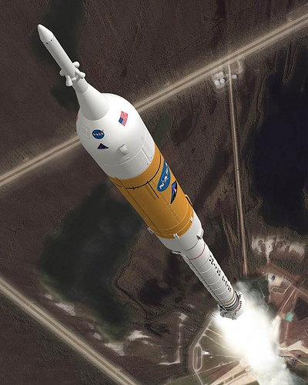
TEST OBJECTIVES
  Timing and Synchronization
  Simulate MCC/Orion dataflows
  Simulate Ares Iaunch/abort dataflows
  Test Automation

Slide 33
Test Connectivity

Slide 34
Test Results
Successfully created Ethernet and Radio transports
  Allowed simulators and Emulators to exchange data
  Provided mechanism to prioritize classes of traffic within the specified bandwidth (QoS feature)
Successfully used GPS Timing and Synchronization
Successfully processed MCC/ORION data flows
Successfully processed Ares I data flows

Slide 35
What Did We Learn?
Seven the hard way

Slide 36
Lessons Learned
  DSILCAS delivers on its promises and it works!
  Successfully overcame technical and bureaucratic hurdles
    Network security
    Alterations to COTS products
    Dynamic network and laboratory environments
  DSILIU-created VPN facilitates collaboration
    VOIP phones
    Network cameras
    Shared virtual whiteboards

Slide 37
WHAT’S NEXT
Constellation plans
  Time trigger Ethernet testing
  Early vehicle integration testing
Non Constellation projects
  Goddard satellite to instrument integration
Additional Interfaces
  1553
  Spacewire

Slide 38
Contact Information
Thomas M. Jackson
DSILCA Project Manager
NASA Goddard Space Flight Center
Phone: (301) 286-4939
E Mail: Thomas.M.Jackson@nasa.gov

Slide 39
The End

Slide 40
Questions?

